Slide 1
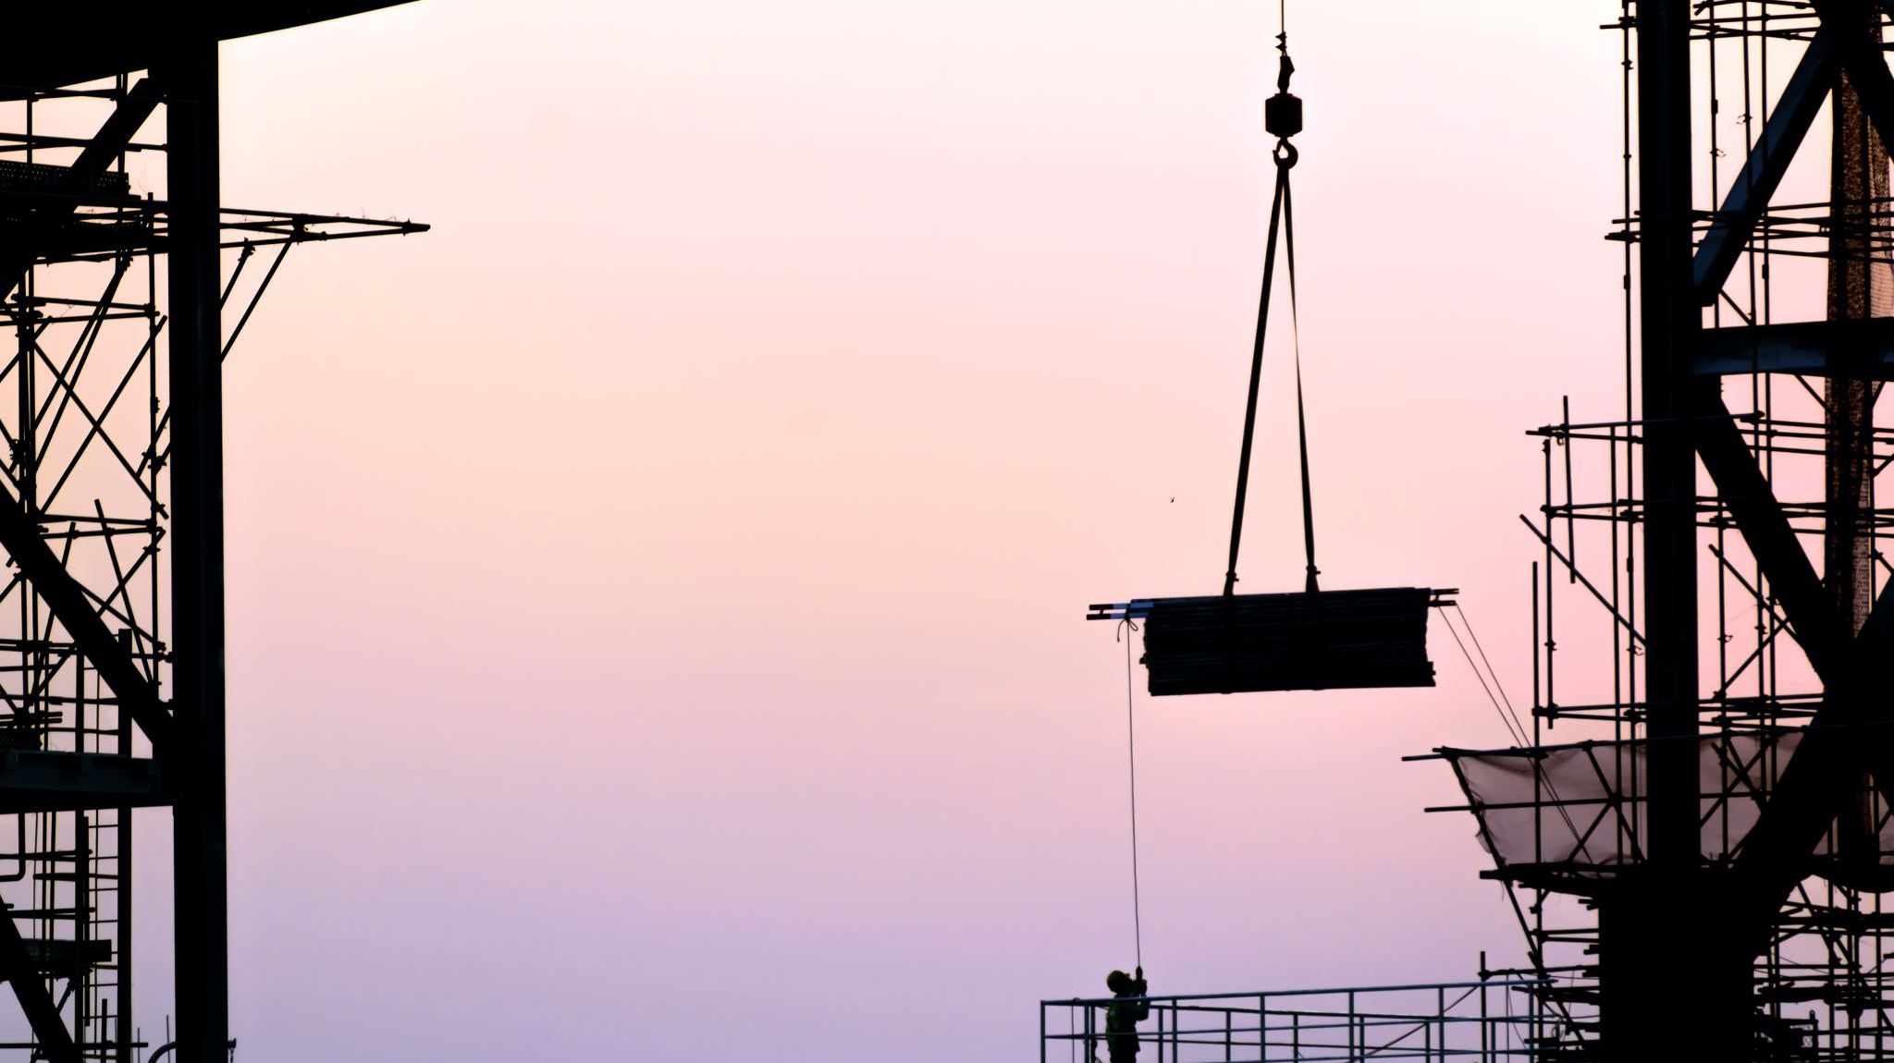

2025 Labor Updates
Presented by Roscoe Mutz
February 19, 2025

Slide 2

Restrictive Covenants
Non-Compete:
Disfavored by AZ Courts
Reasonable in Time and Geography
FTC Final Rule (2024) Proposed Elimination
Non-Solicitation
AZ Courts more likely to enforce
Reasonable by Time and Geography
Confidentiality
Generally enforceable
Limited to truly confidential/trade secrets

Slide 3

Final Paychecks
Potential Pitfalls:
Timeliness
                - 7 working days (Term/Layoff) or next payday
                - Next payday (Resignation)
Setoffs/Deductions
- Acknowledgement from Employee/Good faith
Failure/Refusal to Return Business Equipment
- At least minimum wage

Slide 4

Discrimination/Retaliation
Title VII (Fed), ADA (Fed), ADEA (Fed), etc., and Arizona Civil Rights Act (State):
Generally, should not discriminate or retaliate
Number of Employees Matters
- <15 employees, statutes may not apply
- Sexual Harassment outlier (only 1 employee)

Slide 5

Hostile Work Environment
Employee subjected to severe, offensive, or abusive work environment
So severe that employee was “forced” to quit
Adverse employment action by Employer
“Constructive Discharge”
Difference between strict/accountable and unlawful behavior

Slide 6

National Labor Relations Act (NLRA)
National Labor Relations Act (NLRA):
Applies to both unionized and non-unionized employers
Protected Activities
- Discussing pay, benefits, and work conditions
- Petitions to improve hours
- Refusing to work in unsafe conditions
- Raising complaints with Employer or Gov’t
- Using social media re: work conditions

Slide 7

National Labor Relations Act (NLRA)
Not Protected:
Egregiously offensive or deliberately false statements
Public disparagement if not relating to labor controversy
Threatening violence

Slide 8

Handbooks and Policies
Handbooks or Standalone Policies:
Relevant Arizona Statutes Addressed
- Arizona Paid Sick Leave
- Constructive Discharge Notice
- Deductions from pay / pay corrections
- Drug Testing
- Training Reimbursements
- Protected Activities Catch All
Signed by Employees

Slide 9

Arizona Medical Marijuana Act (AMMA)
AMMA Employee Rights
Employment Protections
- Status as AMMA Cardholder
- Positive Drug Test
- No Recreational (and no use, possession, impairment)
Private Right of Action
Safety Sensitive Positions
Drug Free Workplace Act
Drug Test +

Slide 10

Getting Paid for Your Labor
Project Documentation
Delays
- Document any delays
- Be aware of time limitations on notices and claims
Changes in Work and Change Orders
- Negotiate differences in contract work, time, and/or cost
- Document those changes with a Change Order

Slide 11
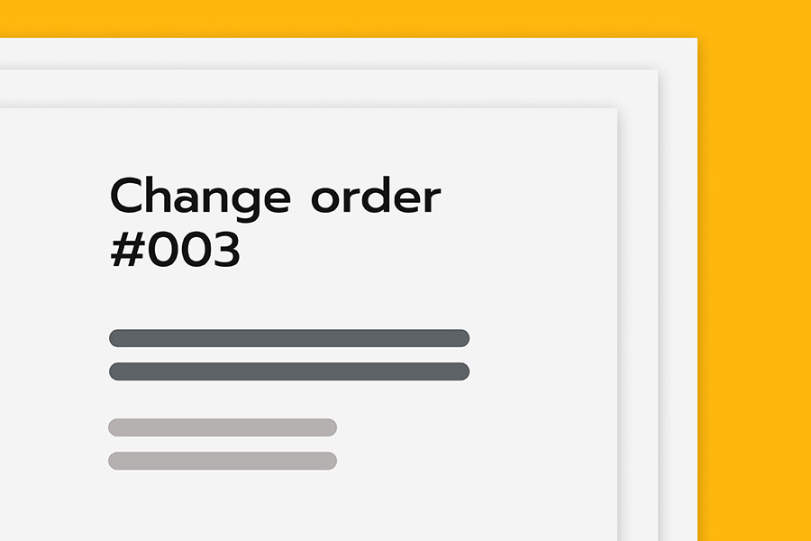
Change Orders
Mini Contract that includes:
New scope of work
Price
Time
Example:
- Substitute 8,000 SF of ceramic tile in place of carpet
- Contract Price increased by $26,000
- Contract Time increased by 5 business days
Generally occur when: (1) Owner requests modifications to existing plan or spec; (2) address imperfections in drawings or specs; or (3) unexpected external factors.

Slide 12

Extra Work
Can Involve Any of the Following:
Changed site condition
Change in work sequencing
Unexpected additional time and/or cost
Change in materials
Delays due to force majeure (Acts of God)
But:
Encountering work that is more difficult than anticipated may not rise to level of change order for extra work.
Encountering materially different site conditions not anticipated by any party may justify CO.

Slide 13
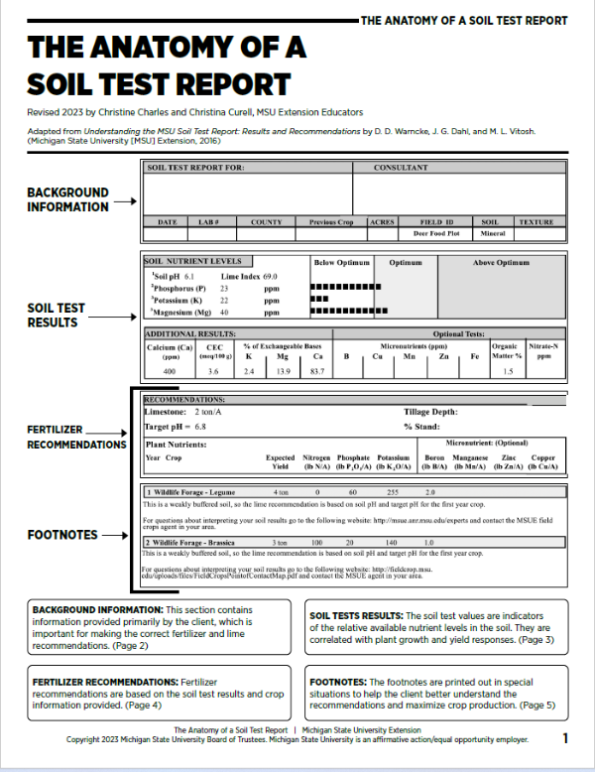
Extra Work
Sample Questions to Ask:
Was there a soils report noting subgrade conditions?
Does the contract include a clause that the contractor has visited the site and familiarized itself with the conditions that may affect its work?

Slide 14

Verify Change Orders/Extra Work
Get it in Writing.
If you cannot get a signed CO in advance, get the basic terms memorialized in an email before work starts and ask for agreement.
Follow up immediately with an invoice for the work.
If an Owner/Contractor confirms that extra work was needed, that it was performed, and that an invoice was sent for the work, it will be difficult for them to argue the work shouldn’t be paid (unjust enrichment or quantum meruit claim can be made)

Slide 15

Amending Preliminary 20-Day Lien Notices
Most CO work is fairly minimal and does not add substantially to the original contract price.
However, if the contract price increases by more that 20%, then an Amended Preliminary 20-Day Lien Notice must be sent.

Slide 16

Warranty Work
If Contractor is obligated to perform warranty work, then generally cannot charge for the warranty work, even if the original job was piecework.
However, if you do maintenance work, you can negotiate an hourly rate.

Slide 17

Thank you!
Questions?
rmutz@farhangmedcoff.com
520-214-2000
farhangmedcoff.com

