Slide 1


Construction Law:
Liens, Prompt Pay and Warranties
Presented by Neal Eckel
November 20, 2024

Slide 2
Liens and Prompt Pay Act

Slide 3

Mechanic’s Lien
Procedure:
Timely serve Preliminary 20-Day Notice TO EVERYONE
Timely prepare, record, and serve the lien
Timely file suit and record lis pendens

Slide 4
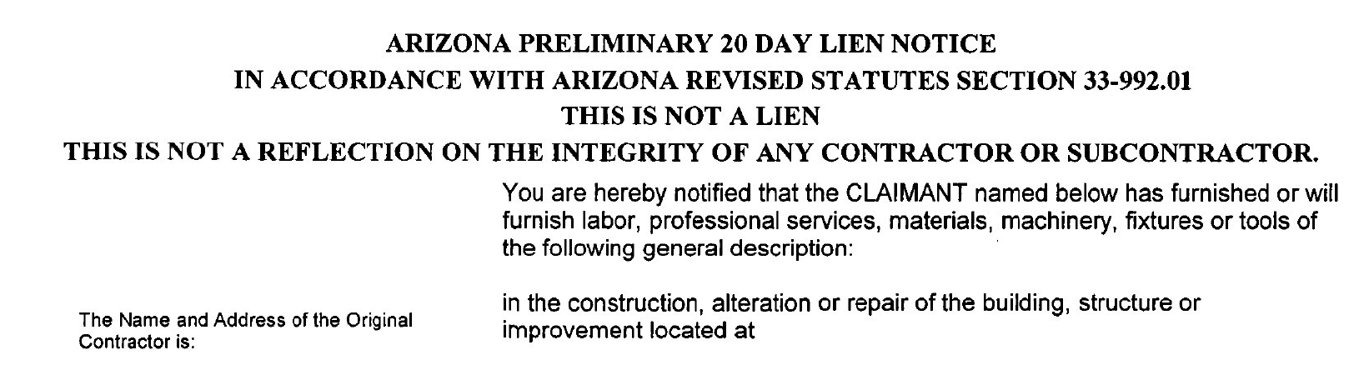
The 20-Day Preliminary Notice
Notice must contain:
  General description of the value furnished and estimate of total price
  Name and address of claimant
  Name and address of person who hired claimant
  Description of property sufficient for identification
  Statutory Notice to property owner, lender, GC

Slide 5
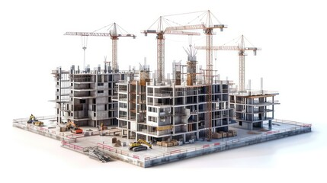
Notice and Claim of Lien
  Must include:
  Legal description of lands and improvements
  Name of owner & person hiring claimant
  Statement of terms or copy of contract
  Lienor’s demand after deducting credits and offsets
  Statement of date of completion
  Copy of 20-Day Notice

Slide 6

Arizona Prompt Pay Act (private work)
A.R.S. §32-1181 et seq. is known as the Arizona Prompt Pay Act and apply only to private work. As will be discussed below, on public projects there are state statutes which provide similar protections for payment.

Slide 7

Certification of Payment
An Owner must pay the Contractor within seven calendar days after the Contractor’s billing or estimate is certified and approved.

Slide 8

Certification of Payment
A billing or estimate is deemed approved and certified 14 days after the Owner receives the billing or estimate, unless before that time the Owner or Owner’s agent issues a written statement detailing those items that are not approved or certified.
A.R.S. §32-1182(D)
Notes:
Source:
‘City of Tucson 2021 General Unofficial Election Results’
https://www.tucsonaz.gov/files/clerks/21GTUC_UnofficialResults.pdf

Slide 9

Timing of Payment
A Contractor must pay its Subcontractors and materials suppliers within seven days after receipt of payment from the Owner.
A.R.S. §32-1183(B)

Slide 10
Timing of Payment
Subcontractors must pay their sub-subs and suppliers within seven days after receipt of payment from the Contractor.

Slide 11

Timing of Payment
The Prompt Pay Act requires that payment shall be made for the full amount received for such Subcontractor’s work and materials supplied based on work completed or materials supplied under the contract.

Slide 12

Timing of Payment
If payments from the Owner to the Contractor are delayed, then payments from the Contractor to the Subcontractors and suppliers will be delayed. The same is true for the timing to approve and certify billings or estimates.

Slide 13

Timing of Payment
Under the Prompt Pay Act the Owner or Contractor may withhold payments to a Subcontractor or supplier for:
unsatisfactory job progress,
defective construction work and materials not remedied,
disputed work or materials,
failure to comply with other material provisions of the contract,

Slide 14

Timing of Payment
claims filed by a third party, or reasonable evidence such a claim will be filed,
failure of the Contractor or Sub-contractor to make timely payments for labor, equipment and materials, damages to the Owner, and
reasonable evidence that the construction contract cannot be completed for the unpaid balance of the construction contract sum or reasonable amount for retention.
A.R.S. §32-1182(B) and 32-1183(B)

Slide 15


Failure to Pay
Failure of a Contractor or Subcontractor to make prompt payment can be grounds for suspension or revocation of their license by the Registrar of Contractors.

Slide 16

Right to Suspend or Terminate Work
Contractors and Subcontractors may suspend work on a construction project or terminate the contract if the Owner does not make timely payment of the amount certified and approved.
A.R.S. §32-1185(A)

Slide 17

Right to Suspend or Terminate Work
No construction contract can alter the right to receive prompt and timely progress payments.
A.R.S. §32-1186

Slide 18

Right to Suspend or Terminate Work
No construction contract can require the application of another state’s laws or jurisdiction.
A.R.S. §32-1186

Slide 19

Applicability to Owner-Occupied Dwelling
The Prompt Pay Act does not apply to owner-occupied dwellings unless you include with each billing or estimate a statement of applicability of the Prompt Pay Act.
A.R.S. §32-1188

Slide 20


Applicability to Owner-Occupied Dwelling
The Prompt Pay Act does not apply to the State of Arizona or any political subdivisions of the state.

Slide 21

Interest Charges
Under the Prompt Pay Act interest on unpaid amounts accrues at 18 percent per annum.
A.R.S. §32-1182(Q) and §32-1183(H)

Slide 22
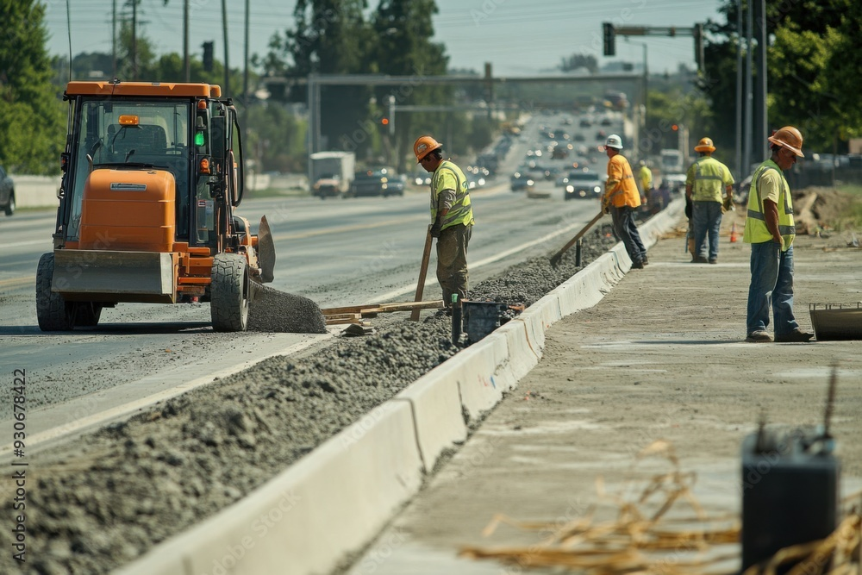
Arizona Prompt Pay Act (public work)
The main difference between the Private and Public Prompt Pay statutes (A.R.S. §34-221) is that in public work the statutes do not provide a right to suspend or terminate work.

Slide 23
Warranties on Construction Projects

Slide 24

Warranties on Construction
There are four kinds of claims that can be made against Contractors on construction projects:
  Registrar of Contractors
  Breach of Contract
  Breach of Implied Warranty
  Negligence
Notes:
Source:
‘City of Tucson 2021 General Unofficial Election Results’
https://www.tucsonaz.gov/files/clerks/21GTUC_UnofficialResults.pdf

Slide 25

Warranties on Construction
Each claim has a different limitation on when it can be brought :
  Registrar of Contractors: Two years
  Breach of Contract: Six years
  Breach of Implied Warranty: Eight years
  Negligence: Two years from date of discovery (must involve personal injury or damage to property)

Slide 26

Registrar of Contractors: Two years
The Registrar of Contractors imposes a two-year period from completion of the work in which it can order corrective work.
The Registrar of Contractors can impose the two-year corrective work order even if your contract specifies a one-year warranty period.

Slide 27

Breach of Contract Action: Six years
In Arizona a party may bring a claim for breach of contract within six years of a breach on a written contract or three years on breach of an oral contract.

Slide 28

Breach of Contract Actions
An express warranty is in writing and says, “we will warrant the work for xx number of years.”
An implied warranty is one imposed by law and requires the contractor to stand by its work for a reasonable amount of time. What is reasonable depends on the expected life of the product installed.

Slide 29
Implied Warranty
Under an implied warranty, an owner can bring an action for construction defects or workmanship even after the six-year limitation period has run on a breach of contract claim.
Under an implied warranty an owner could potentially have a claim for 10 or 20 years or more, especially on a feature that is supposed to last a long time, such as a roof or slab.

Slide 30

The Statute of Repose
Arizona has a Statute of Repose which limits an action against a contractor to eight years from completion of the work.
The purpose of the Statute of Repose is to limit a contractor’s liability for implied warranty claims (which could potentially run for decades).

Slide 31

The Statute of Repose
An action can be brought in the ninth year after completion if the defect is discovered in the eighth year.
This gives the owner a one-year period after discovery to bring the claim.

Slide 32

Thank you!
Questions?
NEckel@farhangmedcoff.com
520-214-2000
farhangmedcoff.com

Slide 33
Employment Law:
Laws that Can Impact Your Business
Presented by Roscoe Mutz
November 20, 2024

Slide 34

Final Paychecks
Potential Pitfalls:
Timeliness
                - 7 working days (Term/Layoff) or next payday
                - Next payday (Resignation)
Setoffs/Deductions
- Acknowledgement from Employee/Good faith
Failure/Refusal to Return Business Equipment
- At least minimum wage

Slide 35

Handbooks and Policies
Handbooks or Standalone Policies:
Relevant Arizona Statutes Addressed
- Arizona Paid Sick Leave
- Constructive Discharge Notice
- Deductions from pay / pay corrections
- Drug Testing
- Training Reimbursements
Signed by Employees

Slide 36

Arizona Medical Marijuana Act (AMMA)
AMMA Employee Rights
Employment Protections
- Status as AMMA Cardholder
- Positive Drug Test
- No Recreational (and no use, possession, impairment)
Private Right of Action
Safety Sensitive Positions
Drug Free Workplace Act
Drug Test +

Slide 37

Thank you!
Questions?
RMutz@farhangmedcoff.com
520-214-2000
farhangmedcoff.com

