Slide 1
Arizona Construction Trades Association
Karen Cesare
CAWCD Board Secretary
June 18, 2025

Slide 2
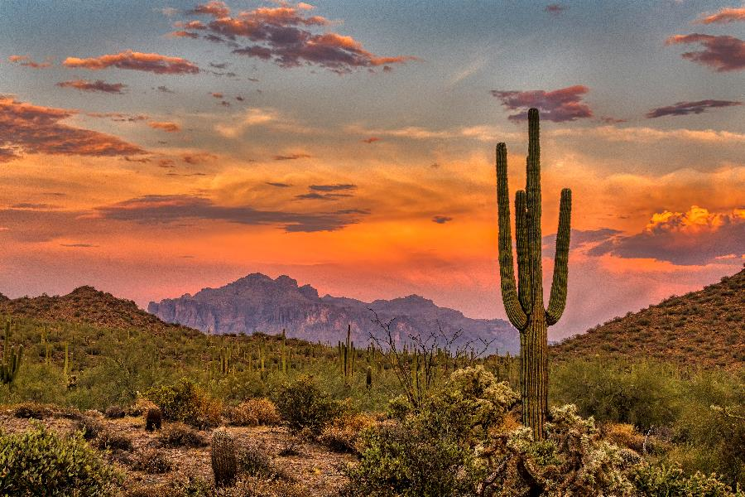
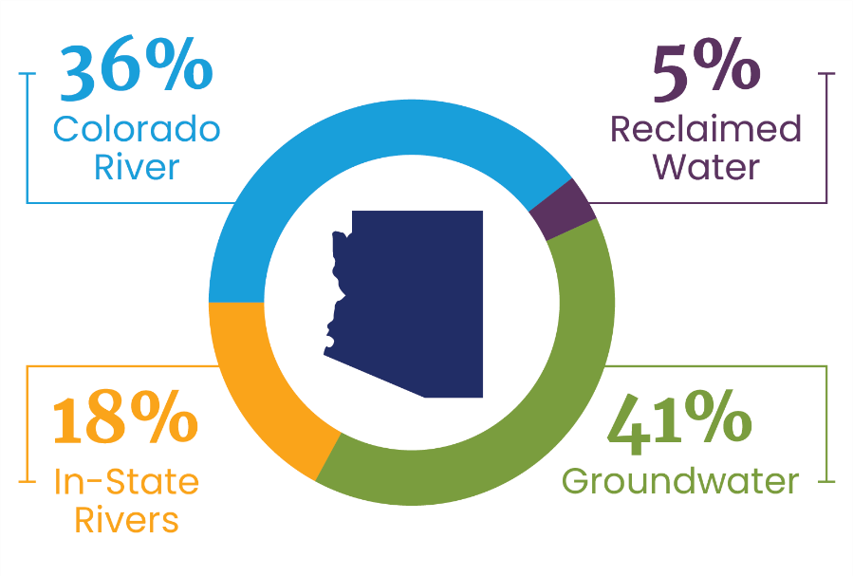
Arizona Water Sources
Notes:
Living in the desert is an amazing and unique experience. But most people ask – how do you have enough water in the desert? While the first answer is that we live here and we know how precious water is and how to conserve – the next answer is that it’s important to know that Arizona has several sources of water:
Groundwater
Colorado River water
Water from in-state rivers (like the Salt, Verde and Gila)
Reclaimed water (used for golf courses and other municipal uses)
When we’re talking about Central Arizona Project, we’re talking about Colorado River water because CAP brings Colorado River water into central and southern Arizona.
Let’s first talk about how that came to be.

Slide 3
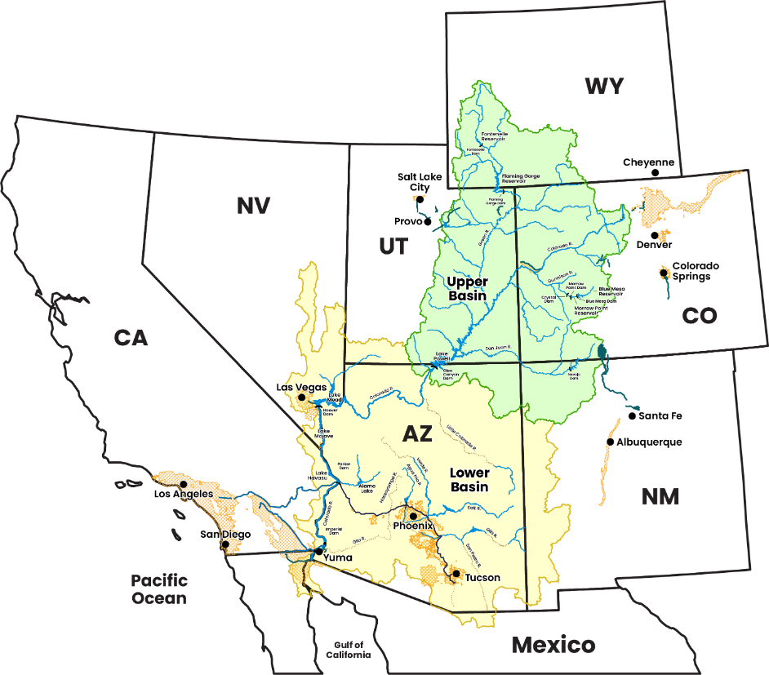
Colorado River Basin
Supplies water to 40 million people
Provides water to Denver, Las Vegas, Los Angeles, Phoenix, Salt Lake City, San Diego and Tucson
Includes 30 Tribes (22 in Arizona)
Irrigates ~5 million acres of farmland
Includes large reservoirs that can store up to 60 million acre-feet of water
Generates clean hydropower for the Western power grid
Supports National Parks, wildlife refuges, recreation areas and monuments
Notes:
First, it’s important to define the Colorado River Basin.
This map shows the states, but also the hydrologic basin – the green is what lies within the Upper Basin and the yellow is what lies within the Lower Basin – note that’s almost entirely Arizona.
Today, the Colorado River Basin:
Supplies water to 40 million people
Provides water to Denver, Las Vegas, Los Angeles, Phoenix, Salt Lake City, San Diego and Tucson
Includes 30 Tribes, 22 of which are in Arizona
Irrigates ~5 million acres of farmland
Includes large reservoirs that can store up to 60 million acre-feet of water
Generates clean hydropower for the Western power grid
Supports National Parks, wildlife refuges, recreation areas and monuments

Slide 4
CAP is foundational to Arizona
Notes:
We all know that water is critical to life everywhere – but moreso in our Arizona desert environment.
CAP brings the Colorado River water into Arizona, which has had an enormous impact on our quality of life and economy.
In that way, CAP is truly foundational to Arizona. We would not be what we are today without the Colorado River water that CAP provides.
We’ll turn our attention now to the history of how Arizona received an entitlement of Colorado River water and how that led to the authorization and construction of Central Arizona Project.

Slide 5
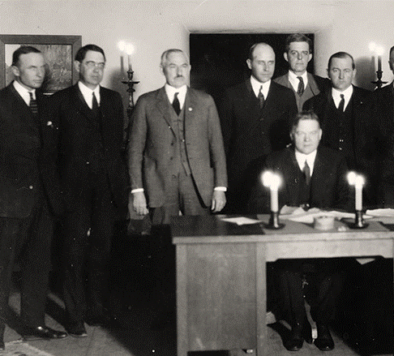
1922 - Colorado River Compact
First agreement to legally connect the Colorado River Basin states
Designated 7.5 maf to the Upper Basin and 7.5 maf mainstem water to the Lower Basin
Creates obligation for the Upper Basin to send at least 75 maf to the Lower Basin for any period of 10 consecutive years
Obligation to Mexico shared equally between basins
Notes:
Arizona wasn’t the only state with its eye on Colorado River water. The seven states in the Colorado River Basin all wanted a share of that water and they had to agree on how to divide it.
In 1922, representatives from the seven states and the United States government created the Colorado River Compact, which divided the states into lower and upper basins.
This was the first time the states were legally connected.
The Compact designated 7.5 million acre-feet to the Upper Basin and 7.5 MAF mainstem to the Lower Basin. It also specified that the Upper Basin send at least 75 MAF to the Lower Basin for any period of 10 consecutive years.
And it specified that any obligations to Mexico would be shared equally.
What is an acre-foot? Imagine a football field covered in a foot of water – that’s a good visual for an acre-foot. One acre-foot of water is enough to serve three Arizona families for a year.

Slide 6
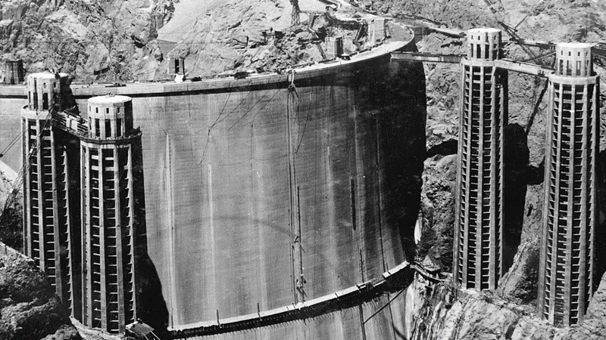
1928: Boulder Canyon Project Act
Authorized construction of Hoover Dam
Identified volumes of Colorado River water for the Lower Basin states:
  Arizona – 2.8 million acre-feet
  California – 4.4 million acre-feet
  Nevada – 300,000 acre-feet
Notes:
In 1928, the Boulder Canyon Project Act authorized the construction of Hoover Dam and set the Lower Basin apportionments –
Arizona – 2.8 million acre-feet
California – 4.4 million acre-feet
Nevada – 300,000 acre-feet

Slide 7
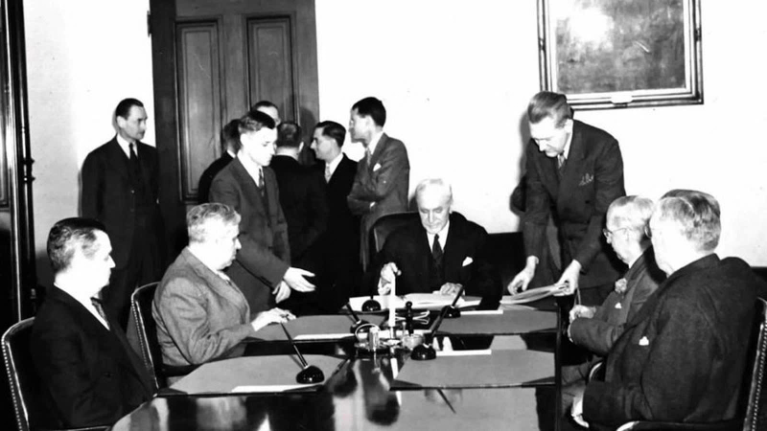
1944: U.S. Mexico Water Treaty
Apportioned 1.5 million acre-feet per year of Colorado River water to Mexico
Specified that Mexico would share in times or surplus and in reductions due to “extraordinary drought”
Established the binational International Boundary and Water Commission to implement the Treaty
Notes:
Next, in 1944, the U.S. Mexico Water Treaty brought Mexico into the mix, apportioning 1.5 million acre-feet per year of Colorado River water to them.

Slide 8
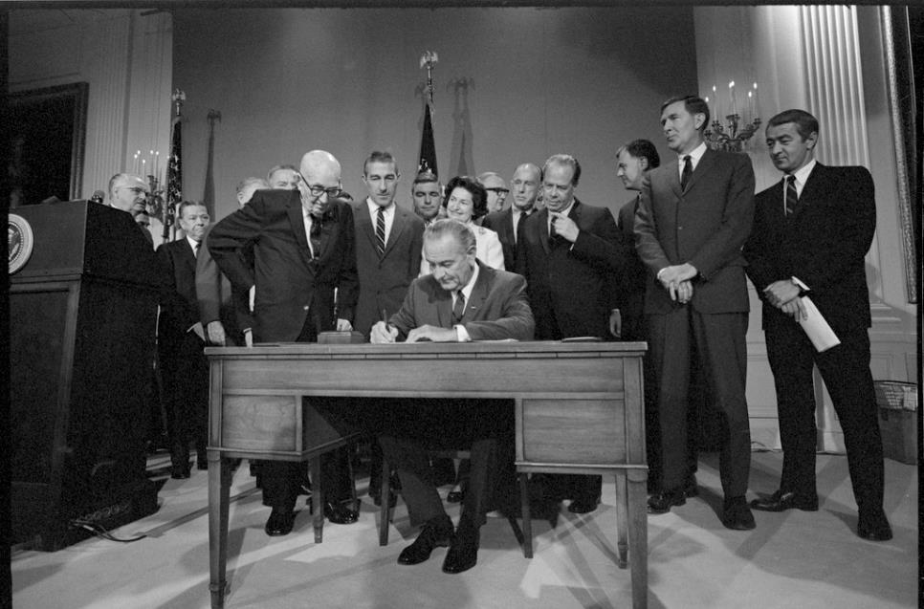
1968: Colorado River Basin Project Act
Signed into law by President Lyndon B. Johnson on Sept. 30, 1968
Authorized construction of Central Arizona Project
Notes:
Finally, in 1968 the Colorado River Basin Project Act was signed into law by President Lyndon B. Johnson.
The Colorado River Basin Project Act authorized construction of the CAP system – although construction didn’t begin for five more years as the funding still needed to be allocated.

Slide 9
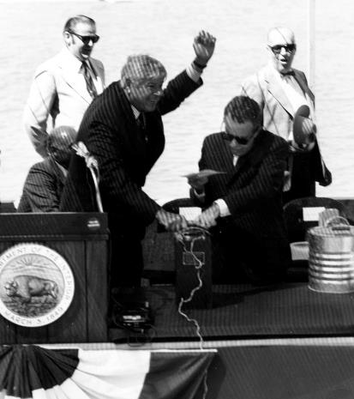
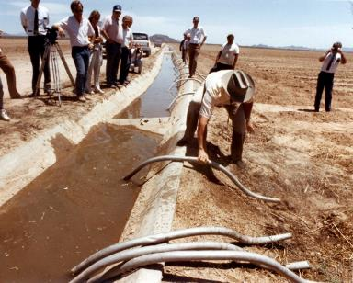
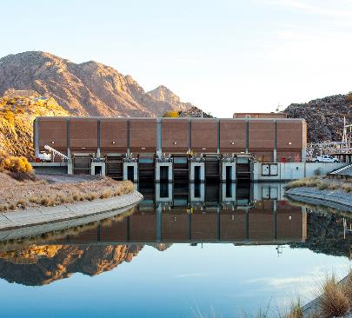
CAP’s 20-Year Construction
1973: Bureau of Reclamation begins construction of CAP
1985: First CAP water delivery – Harquahala Valley Irrigation District
1993: Construction is complete, costing roughly $4 billion, $1.65 billion of which must be repaid to the federal government
Notes:
In 1973 – five years after it was authorized – CAP construction finally began!
Shown here in the upper left-hand picture is Secretary of the Interior Rogers Morton initiating the first blast for the construction of the Mark Wilmer Pumping Plant, which is off the Colorado River, near the Arizona/California border right around Lake Havasu City.
Construction was a massive undertaking. It took 8 years and 100 miles until the first CAP water delivery in 1985. The first water was delivered to the Harquahala Valley Irrigation District – to farmers that had previously been on groundwater. In the middle photo you can see the water first coming into the canal with a farmer getting right in there to get his irrigation line into the canal!
Finally – 25 years after it was authorized and 20 years after construction began – the CAP system was complete in 1993.
In all, the system cost $4 billion to construct. And, according to our contract with the federal government, we need to repay $1.65 billion of that.

Slide 10
CAP connects Arizona communities
Notes:
Whether your community receives Colorado River water from CAP or not, if you live in Arizona, you are likely somehow connected to the Central Arizona Project.
Certainly that’s true for the cities, towns, private water companies and tribes that receive Colorado River Water via CAP.
But it’s also true for those who benefit from the economic impact this water has provided.
You might have seen parts of the CAP canal crossing through your community, but that’s only a small part of what is truly an engineering marvel.

Slide 11
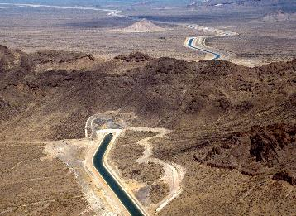
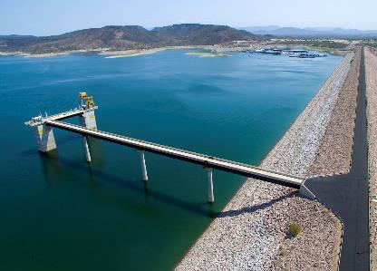
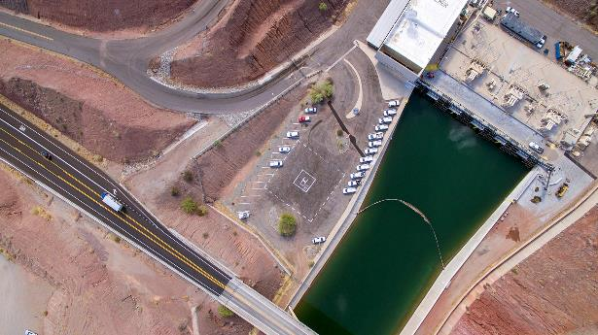
Today’s Central Arizona Project
– an Engineering Marvel
336-mile aqueduct stretching from Lake Havasu to Tucson:
14 pumping plants -- lift water nearly 3,000 feet
10 siphons, 4 tunnels
More than 50 turnouts that deliver the water
Lake Pleasant storage reservoir/New Waddell Dam and Waddell Pump Generating Plant
CAP is committed to caring for this valuable infrastructure, ensuring reliability 24/7/365.
Notes:
Today, the CAP system is a 336-mile aqueduct that stretches from Lake Havasu to just south of Tucson.
It includes:
Fourteen pumping plants that lift water, uphill, nearly three thousand vertical feet over the course of the system
10 siphons and four tunnels
More than 50 turnouts to deliver water to Central and Southern Arizona
Lake Pleasant storage reservoir and New Waddell Dam and Waddell Pump Generating Plant

Slide 12
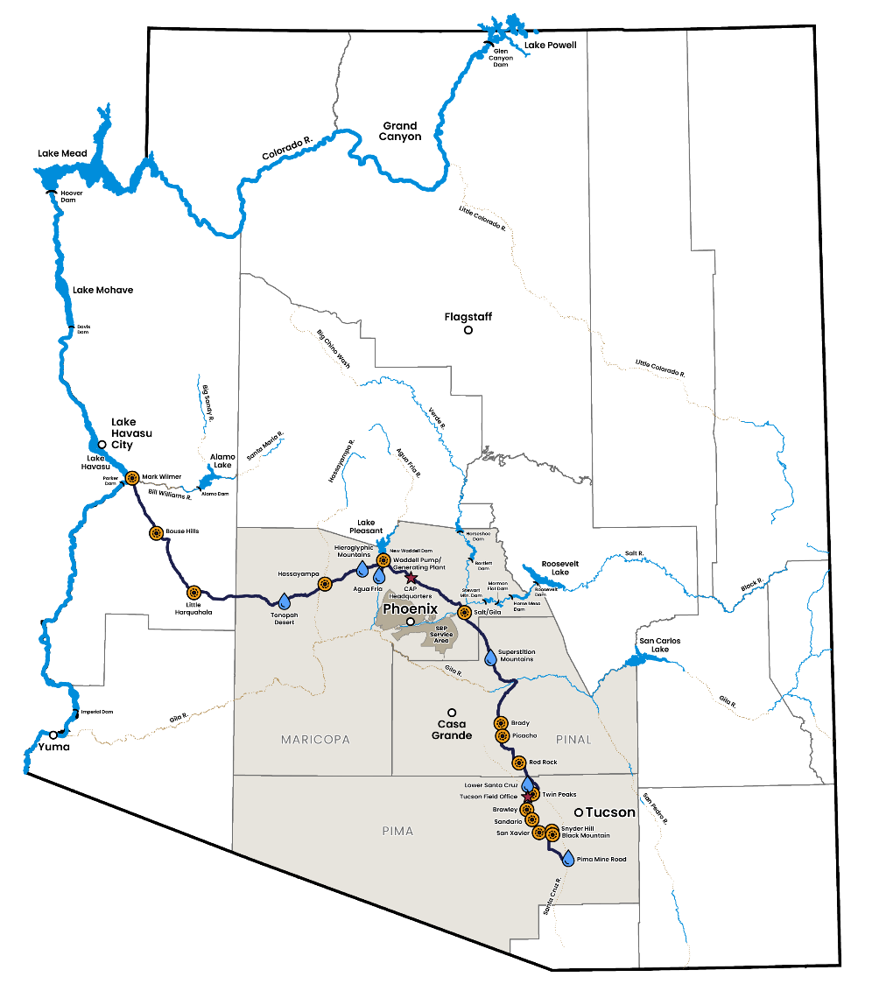
CAP Service Area
More than 80% of Arizona’s population (6 million+ people)
3 Counties
  Maricopa
  Pinal
  Pima
11 tribal nations
CAP delivers more tribal water than any other organization in the United States.
Notes:
Who gets the water?
CAP delivers water to the region in central and southern Arizona where six million people reside – Maricopa, Pinal and Pima counties.
Eleven of Arizona’s 22 tribes have rights to CAP water – that’s more than 1/3 of the tribes in the Colorado River Basin. CAP delivers more tribal water than any other organization in the United States.

Slide 13
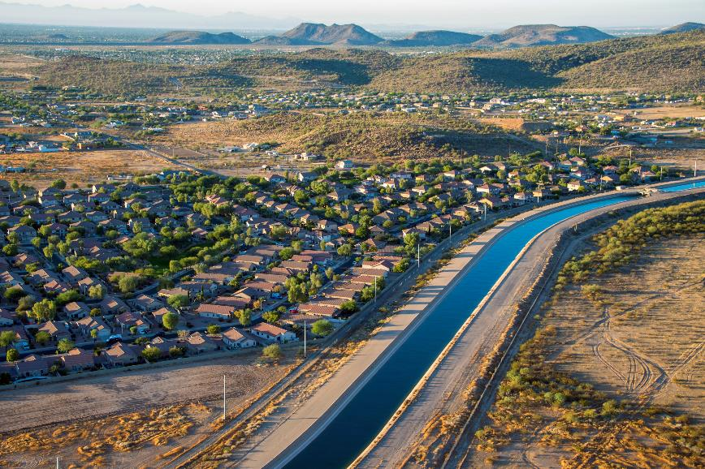
CAP Contracts
CAP’s valuable infrastructure is necessary to communities across the state, providing connections among water supplies and systems.
CAP supply is allocated by contract:
  54% to municipal/industrial
  46% to tribes
  Until recent reductions, CAP historically served agricultural users
Notes:
54% of the water is allocated by contract to municipal/industrial water users, which refers to the cities, towns and private water customers that treat and deliver water to their customers – or store it for future use.
And 46% of the water is allocated to tribes that can use the water in their communities or lease the rights.
It’s also important to note that until recently, CAP historically served agricultural users. Due to Colorado River shortage, which we’ll discuss in a moment, ag is no longer receiving water directly from CAP.

Slide 14
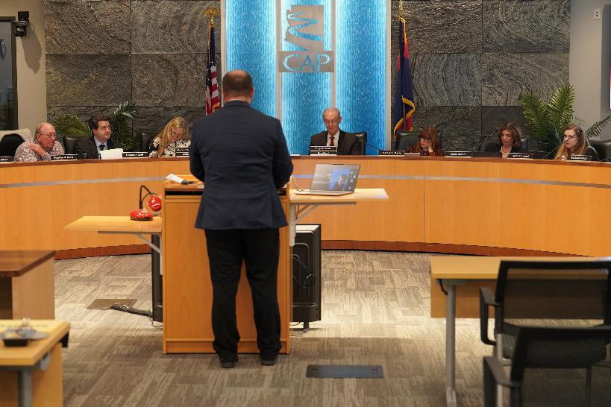
CAWCD Governance
CAWCD is governed by a 15-member Board of Directors
Each Board member is elected from CAP’s three-county service area and serves a staggered, unpaid six-year term
  10 from Maricopa County
  4 from Pima County
  1 from Pinal County
Notes:
Before CAP’s construction began, the Central Arizona Water Conservation District was formed in 1971 to oversee Central Arizona Project.
The Board has 15 members elected from CAP’s three-county service area. We serve staggered, six-year terms.

Slide 15
CAP provides water security for Arizona
Notes:
So, CAP delivers Colorado River water. There’s been a lot in the media in recent years about the shortage on the Colorado River. And CAP has been in the midst of near-constant negotiations regarding the Colorado River.
Although the issues are quite complex, here’s a brief overview regarding where we’re at with Colorado River issues and where we’re headed.

Slide 16
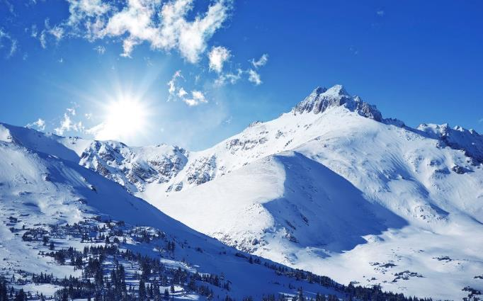
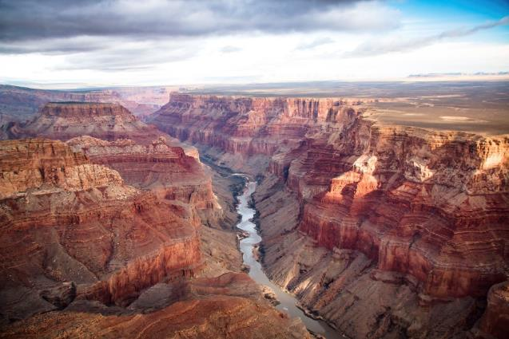
25 years of Colorado River drought
Snowpack vs. Runoff (% of average)
 | Snowpack | Runoff
2020 | 105% | 61%
2021 | 86% | 37%
2022 | 90% | 63%
2023 | 161% | 140%
2024 | 114% | 83%
Notes:
One of the reasons you’ve been hearing about the Colorado River in the media in recent years is because of the change in the snowpack/runoff cycle. Due to two-plus decades of drought and the effects of climate change, we’re dealing with a smaller Colorado River than we were at the beginning of this century.
The Colorado River water that makes its way to Arizona depends on snowpack and runoff in the Rocky Mountains. Over the past several years, we have seen that even in years with decent snowpack, we have reduced runoff. One of the reasons is because the ground has been so dry that the moisture is being absorbed into the soil before making its way to the river.

Slide 17
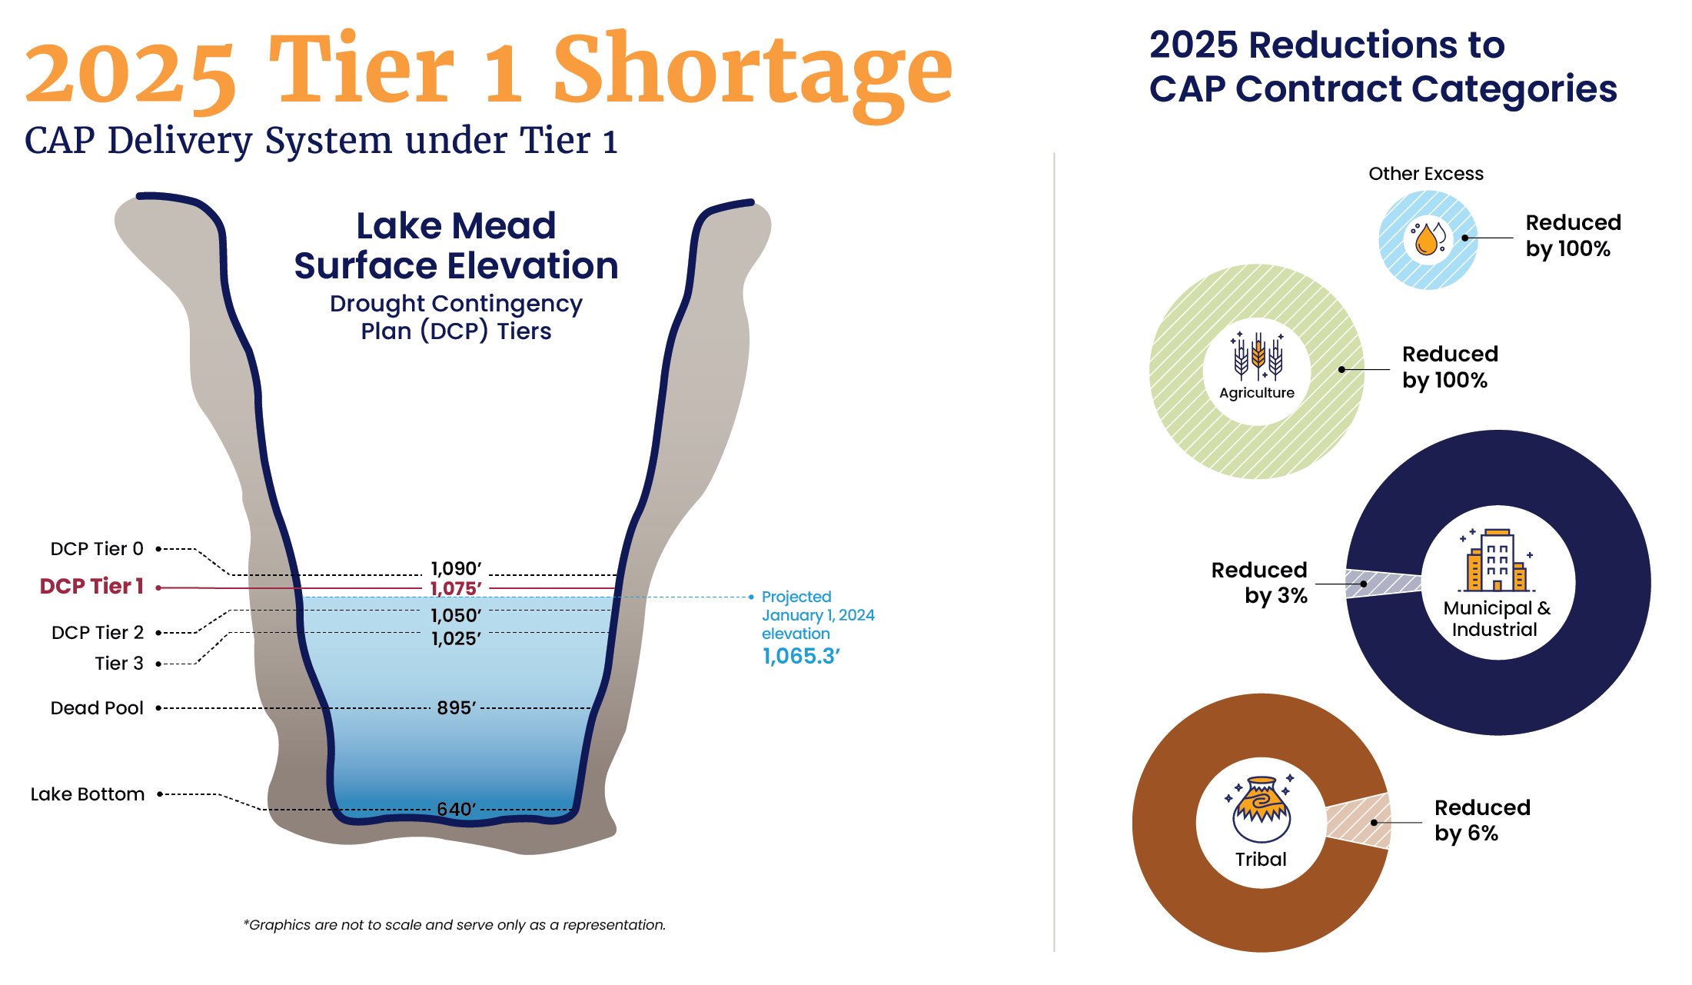
Notes:
As a result of this reduced runoff, the Colorado River Basin has been operating under shortage conditions since 2020. Here’s how that affects CAP water users.
The left-hand side depicts Lake Mead. Based on the level of Lake Mead, we are in Tier 1 shortage conditions. This means Arizona receives a reduction of 512,000 acre-feet to our Colorado River supply and that is borne entirely by CAP.
On the right hand side, you see how that affects CAP’s supplies:
We no longer have what was called “excess water.”
We used to serve agricultural water users, but that supply is no longer available. There’s a whole story there about how farmers and irrigation districts negotiated for a lower priority supply for a lower price. Ultimately, this meant they would no longer have CAP supplies – it just came sooner than expected because of Colorado River shortage.
Supplies to cities and businesses are reduced by 3 percent.
Supplies to tribes are reduced by 6 percent.

Slide 18
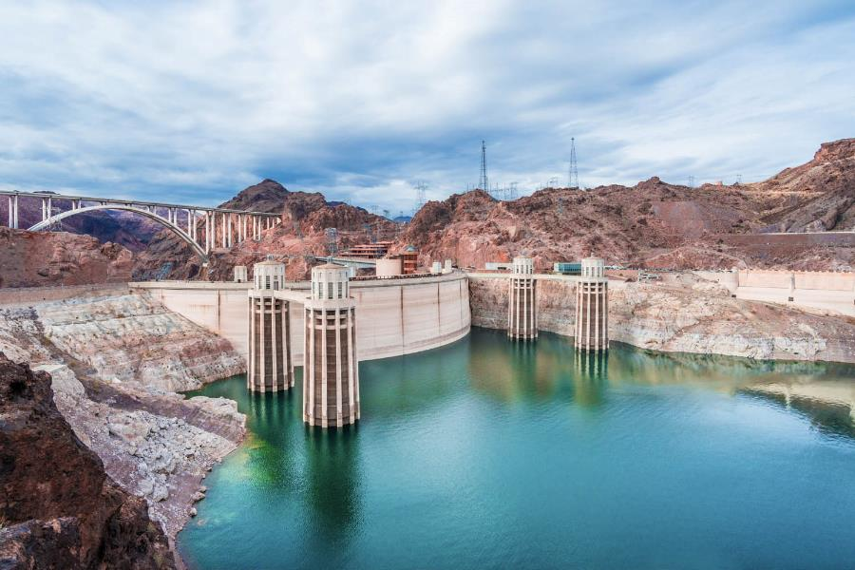
Colorado River Operations through 2026
2007 Interim Guidelines
Established a shortage framework for the Lower Basin based on elevations in Lake Mead
Incentivized storage of water in Lake Mead
Coordinated operations of Lake Powell and Lake Mead
20-year term – 2007-2026 (2019 Drought Contingency Plan was an overlay due to declining reservoirs)
Notes:
Now we’ll turn our attention to some of the most recent agreements that make up the legal framework for how the river is operated – often known as the “Law of the River.” We covered many of the early parts at the beginning of the presentation. Now, we’ll look at where we are today.
Right now, we’re operating under what’s known as the 2007 Interim Guidelines, which is overseen by the Bureau of Reclamation. Lower Basin operating conditions are based on the level of Lake Mead.
In 2019, Congress approved the Drought Contingency Plan, which was an overlay to these guidelines due to the declining health of the Colorado River due to drought and climate change.

Slide 19
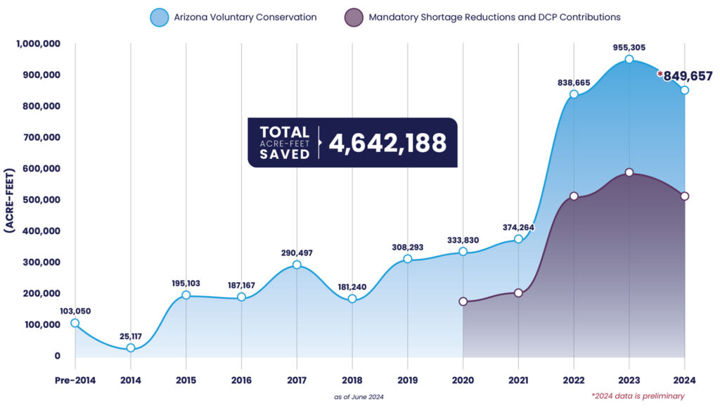
Large-scale conservation
Arizona has conserved approximately 4.6 MAF through 2024
This equates to nearly 67 feet in Lake Mead

Slide 20
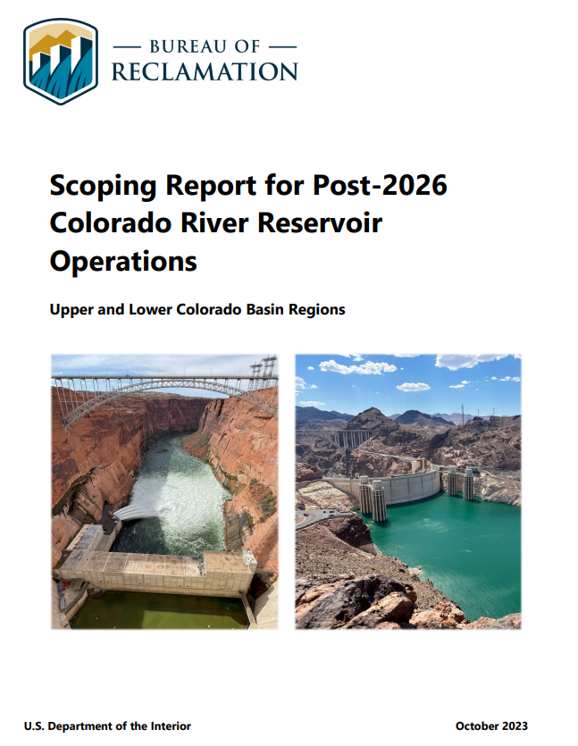
Post-2026 Colorado River Operations
Bureau of Reclamation initiated a National Environmental Policy Act process in June 2023
The Lower Basin states agree that future operations should:
  Improve Colorado River reliability over a broad range of future conditions
  Share the risks and benefits of the system within and between the basins
  Improve predictability of reductions to stabilize Lake Mead
Additional work with stakeholders, water users, and Upper Basin interests is needed to reach consensus
Notes:
The current guidelines for Colorado River management expire in 2026.
Reclamation has initiated an environmental process to start the ball rolling on new guidelines, and the Lower Basin states have developed an alternative that considers the health of all Basin reservoirs.
The ADWR Director represents Arizona/Governor in negotiations on the Colorado River between the 7 Basin States. CAWCD supports this process, bringing its own Policy, Legal and Technical expertise to these negotiations to protect the interests of our water users.
To develop Arizona’s perspective on what the future Colorado River management should look like, CAP and ADWR have formed the Arizona Reconsultation Committee (ARC), which consists of more than 40 water stakeholders from throughout the state representing cities, Tribes, agriculture, NGOs, industries and the legislature.
Arizona stands ready to do more, but if hydrology significantly worsens, reductions must be shared throughout the Basin and must adhere to the Colorado River Compact.
Additional work is still ongoing with stakeholders, water users and Upper Basin interests.

Slide 21
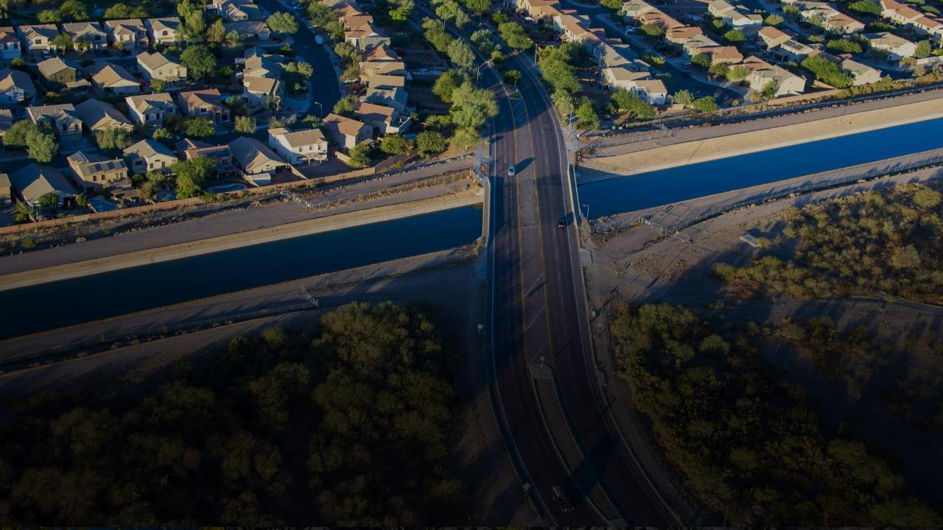
Central Arizona Groundwater Replenishment District

Slide 22
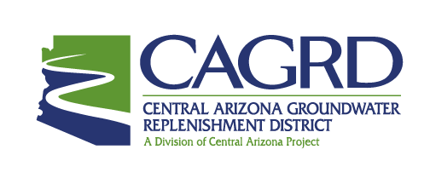
What is CAGRD?
Central Arizona Groundwater Replenishment District (CAGRD) was created in the mid-1990s to help water providers and landowners comply with Arizona’s groundwater laws
CAGRD plays an important role in Central Arizona’s groundwater management by replenishing groundwater pumped by its members

Slide 23
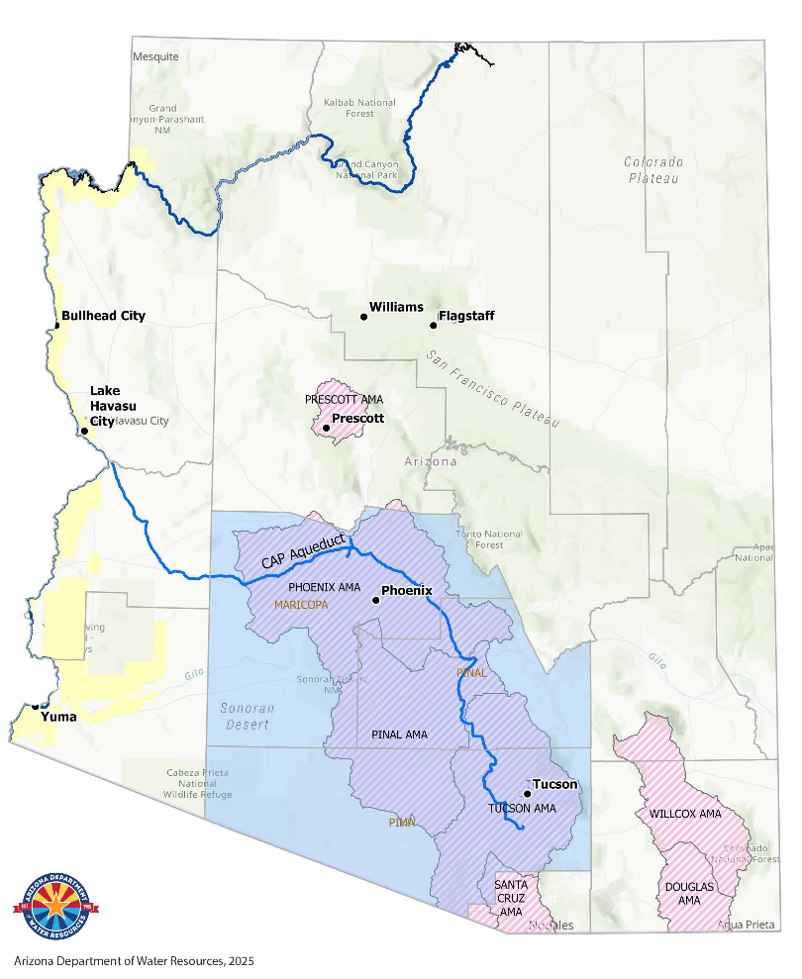
Arizona Groundwater Management
1980 - Arizona passed the Groundwater Management Act, one of the toughest sets of groundwater laws in the country
Regulated groundwater pumping in the most populated areas including Phoenix, Tucson and Pinal
Created the Assured Water Supply Program
Notes:
To better understand CAGRD and what it does, it's important to look back in time:
In 1980, the legislature adopted the Groundwater Management Act which regulated groundwater pumping in populated areas of the state, called Active Management Areas. Highlighted on the map.
The Assured Water Supply Rules, later established in 1995, limited the quantity of mined groundwater new development could use in the AMAs.
.
The “CAGRD” was created to provide a mechanism for landowners and water providers reliant on groundwater to comply with the rules by replenishing groundwater that is pumped

Slide 24
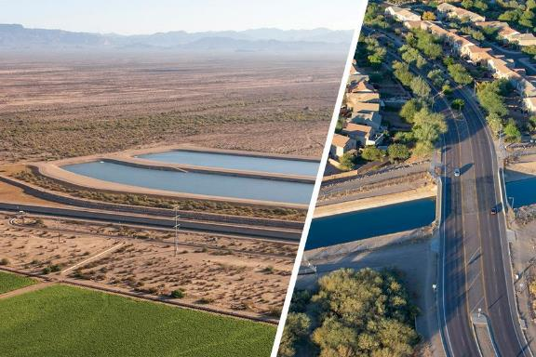

CAGRD’s Relationship to CAP
Not a separate entity – a special function of CAP
Governed by the CAWCD Board of Directors and serves members in Maricopa, Pima & Pinal counties
Financially separate – funded solely by members
Notes:
The Arizona Legislature gave CAP these replenishment responsibilities under the name of the Central Arizona Groundwater Replenishment – so, CAGRD is not a separate entity, but a special function of CAP
CAGRD and CAP both serve the same three-county service area – Maricopa, Pima and Pinal and they are both governed by the same 15-member elected Board
CAGRD is funded solely by its members

Slide 25
Assured Water Supply Rules
AZ’s Assured Water Supply Rules require that before recording plats or selling subdivided parcels within Active Management Areas (AMAs), developers must first demonstrate a number of criteria:
100-year availability
  Physical
  Continuous
  Legal
Adequate water quality
Financial capability
Consistency with the AMA Management Goal and Management Plans
Notes:
To understand CAGRD, it’s important to first understand Arizona’s Assured Water Supply Rules.
These require that – before recording plats or selling subdivided parcels within designated Active Management Areas (areas that ADWR has identified as having a heavy reliance on groundwater), developers much first demonstrate a number of criteria.

Slide 26
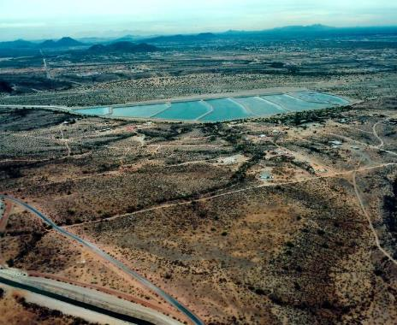
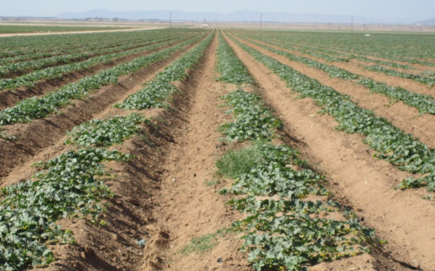
Ways CAGRD Replenishes
Agua Fria Recharge Project
Maricopa-Stanfield Irrigation and Drainage District
Notes:
The CAGRD can either:
* Send water to a large spreading basin, as shown on the left, where the water will percolate into the ground, reaching into the aquifer
* Or by sending water to a farm on an irrigation district, as shown on the right. These irrigation districts, commonly referred to as Ground water Savings facilities, preserve groundwater they would have otherwise pumped by using CAP water. CAGRD is then credited an equal amount for replenishment.
Currently, each year, CAGRD replenishes about 30,000 acre-feet water back into Arizona’s aquifers – when you consider that one acre-foot serves three average-sized Arizona families for one year – you can see that’s a lot of water!

Slide 27
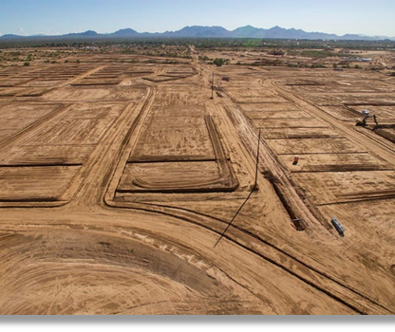
Who joins CAGRD?
Two types of members:
  Member Service Areas (MSAs)
    City, town or private water company
    Currently 23 MSAs enrolled
  Member Lands (MLs)
    Subdivisions
    Nearly 1,300 enrolled MLs
Notes:
CAGRD enrolls two types of members:
Member Service Areas (MSAs), which are: cities, towns or private water companies. Currently there are 23 enrolled MSAs.
Member Lands (MLs), which are subdivisions. There are nearly 1,300 enrolled MLs

Slide 28
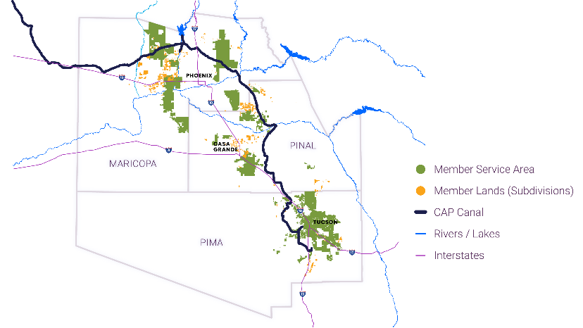
CAGRD Members
Notes:
This is a map of CAP’s three-County service area:
Green represents the Member Service Areas
Orange represents Member Lands Subdivisions

Slide 29
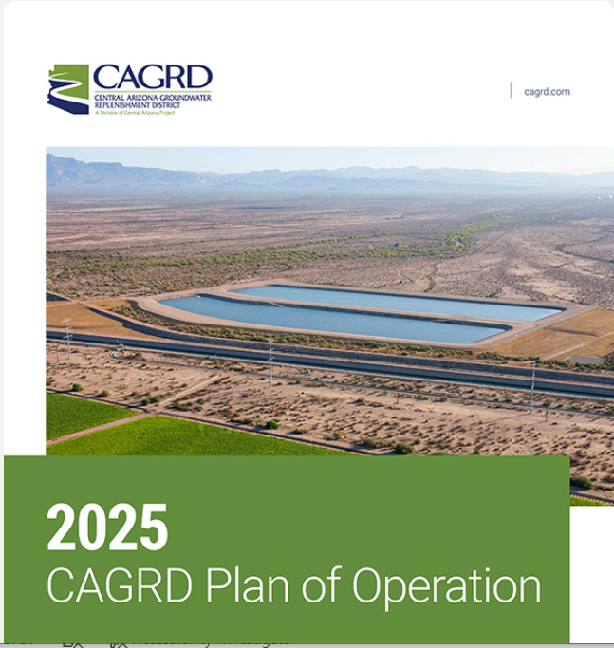
CAGRD Plan of Operation
By statute, CAGRD operates under a 10-year Plan of Operation.
All Plans have been developed with public input and have been approved by ADWR.
Describes the projected obligations and water resources to meet those current and future obligations.
The 2025 CAGRD Plan of Operation has been submitted to ADWR and is in the public comment period
Notes:
By statute, CAGRD operates under a 10-year Plan of Operation.
All Plans have been developed with public input and have been approved by ADWR.
The 2025 Plan has been submitted to ADWR. Highlights include that CAGRD:
Met and continues to meet its replenishment requirements;
NO longer relies on CAP excess water and has sufficient supplies to meet its projected 20-year obligation; and,
Has identified potentially available supplies that could be used to meet its obligations over the next 100 years

Slide 30
What’s next?

Slide 31
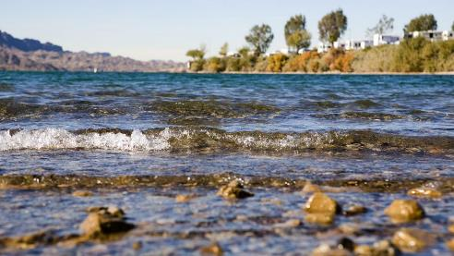
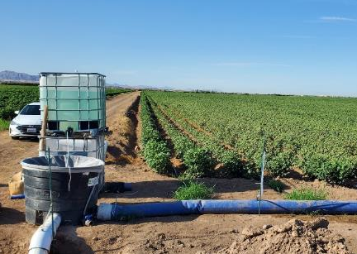
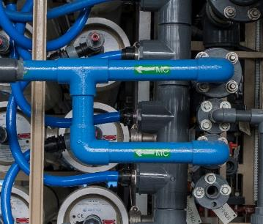
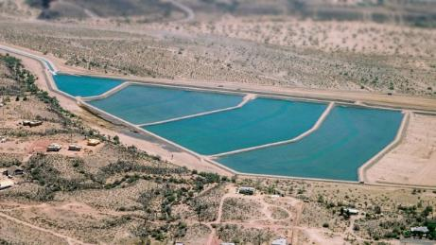
Long-Term Solutions and Partnerships
Negotiations – Maintaining fair share of Colorado River supply
Augmentation – Finding new water supplies
Conservation Efficiency – Helping users with conservation efforts
Reuse – Supporting studies about recycled water
Recovery – Recovering water stored underground
Recovery
Focusing on efficient ways to recover water that has been stored underground
Notes:
Beyond post-2026 operations, other longer-term solutions for Arizona include:
Augmentation – We’ll be looking toward additional supplies to supplement the Colorado River supply, including perhaps, desalination and moving non-Colorado River supplies through our canal, a process referred to as “wheeling”
Conservation – We’ll continue to treat our water supplies as the precious resource they are by finding innovative ways to conserve. Examples include studies that may allow agriculture to maintain its yield while using less water, and Brock Reservoir near Yuma, which captures water that might otherwise be lost to the system.
Reuse – We’ll work with others in the Basin, including Metropolitan Water District of Southern California and the Southern Nevada Water Authority, exploring ways to purify and treat wastewater for reuse.
Recovery – We’ll focus on efficient ways to recover the water that has been stored underground.
These are all things our communities are working on and in many ways CAP is supporting these efforts.

Slide 32
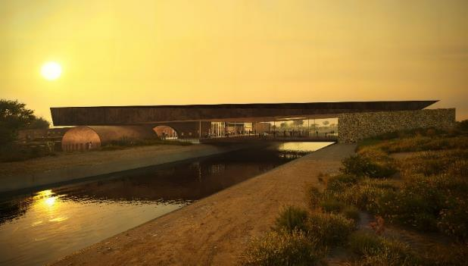

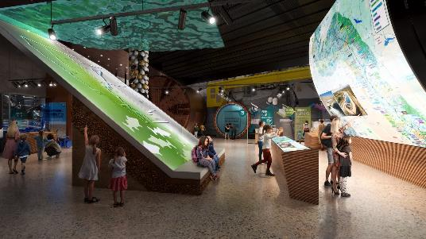

CAP Water Education Center
New accessible space to be built on the CAP Headquarters campus to offer visitor experiences that explore CAP’s:
  History
  Operations
  Impact on Arizona
Groundbreaking: May 2025
Opening: Late 2026
Notes:
The CAWCD Board has approved construction of Water Education Center at CAP’s north Phoenix Headquarters. This will allow visitors to experience CAP’s history, operations and impact on Arizona.
Groundbreaking will be May 2025 and the center is scheduled to open in late 2026.

Slide 33

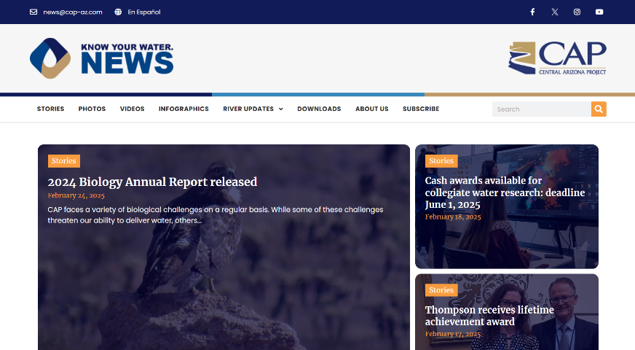

Stay Informed!
Visit and subscribe to CAP’s news site – KnowYourWaterNews.com
Enroll in CAP University (visit CentralArizonaProject.com and search for upcoming dates)

Slide 34
Thank You!

