Slide 1
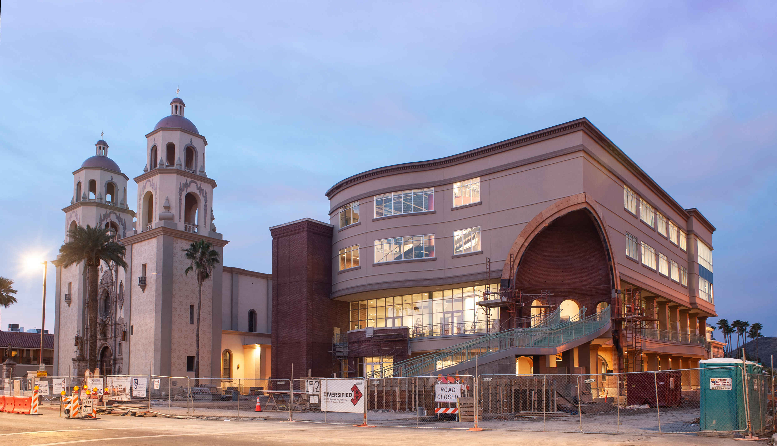




2025 Code Adoption (2024 I-codes)
A presentation for Arizona Construction Trades

Slide 2
Agenda
City of Tucson
  Adoption process and timeline
  Key plumbing code changes
Pima County
  Regional amendments and resources
  Key electrical code changes
Oro Valley
  Amendments and resources
  New to Oro Valley
Sahuarita
  Resources and process
  Additional key code changes

Slide 3
Code Adoption Process
Review with consolidated code committee (TPCJCC)
Prepare amendments in partnership with other jurisdictions
Train staff on code changes
Public outreach
Mayor and Council first, then Board of Supervisors
Public notification
Implementation

Slide 4
Code Adoption Timeline
11 public meetings thus far in 2024
January/February meetings in 2025 will be focused on IECC
March/April meeting before Mayor and Council
Target implementation July 1, 2025
Applicable code determined by permit application date

Slide 5
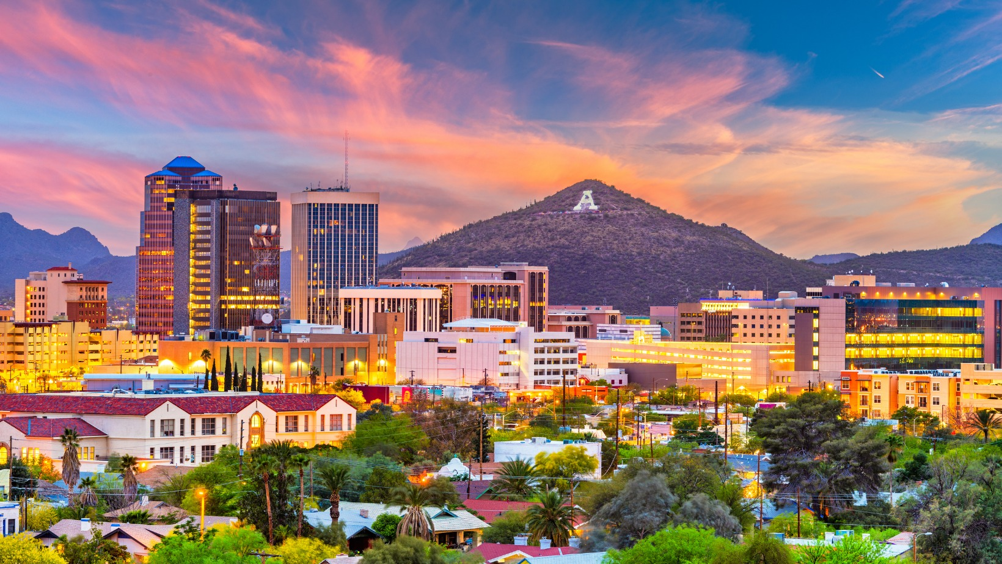

Key Plumbing Code Changes
Clayton Trevillyan, CBO
January 15, 2025

Slide 6
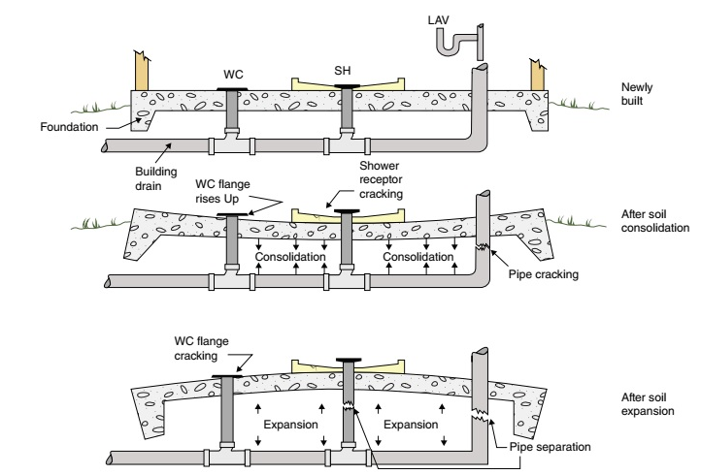
IPC 305.8 – Piping in expansive soil
“Where expansive soil is identified…”
Isolated foundations shall have piping suspended
Committee approval vote 10-4
Will not apply to sites using engineered fill
Photos courtesy of ICC, Getty Images, & MirageC/Moment

Slide 7
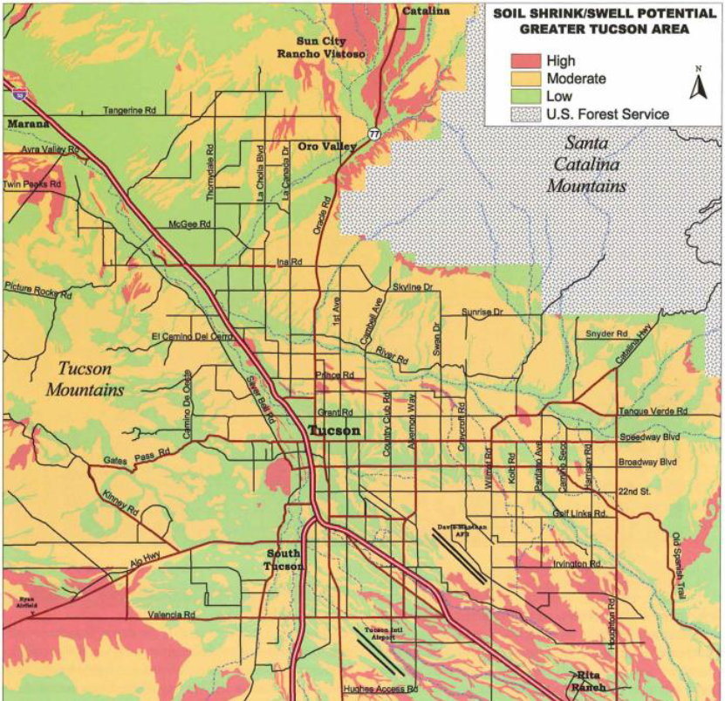
Expansive Soils Map – Tucson, AZ
WEBLINK

Slide 8
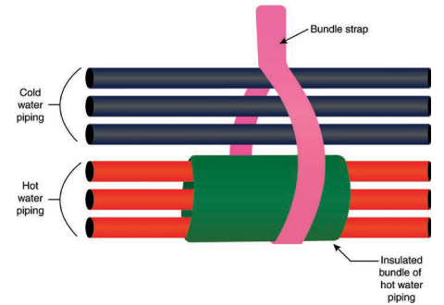
IPC 308.9 – Bundling of hot water lines
“Where hot water piping is bundled with cold or hot water piping, each hot water pipe piping shall be insulated…”
Photos courtesy of ICC, Getty Images, & MirageC/Moment

Slide 9
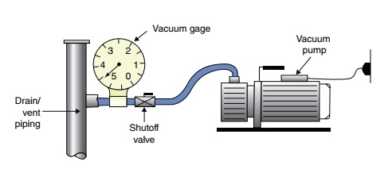
IPC 312.4 – Vacuum testing for DWV
Negative 5 pounds per square inch OR
Negative 10 inches of mercury column (-34 kPa)
Minimum 15 minutes

Slide 10
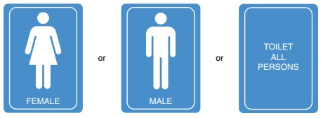
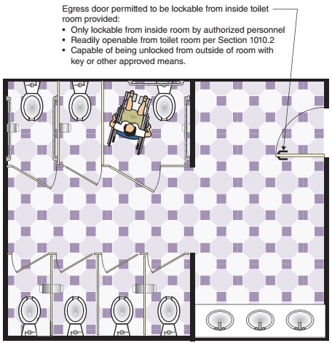
IPC 403.3.6 – Multiple user vs Single user restrooms and door locks
New definitions
Fixture calculations no longer need to be segregated
New signage requirement
Restriction on door locks
Photos courtesy of ICC, Getty Images, & MirageC/Moment

Slide 11
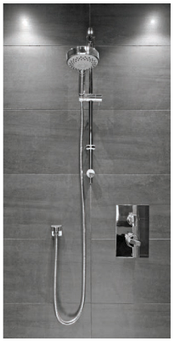
IPC 412.3 – Shower heads must match the control valves
“Shower control valves shall be rated for the flow rate of the installed shower head.”
Resulting from reduced flow fixtures and fixture heads
Mixing valves must be rated for the head to prevent temperature shock
Photos courtesy of ICC, Getty Images, & MirageC/Moment

Slide 12
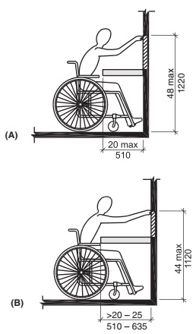
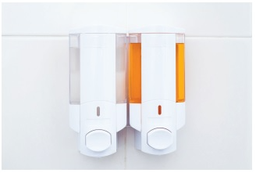
IPC 419.6 – Soap dispensers
“Soap dispenser shall be provided for public lavatories.”
Permanently mounted or portable
Standard reach ranges apply
Sealed to prevent moisture intrusion
Photos courtesy of ICC, Getty Images, & MirageC/Moment

Slide 13
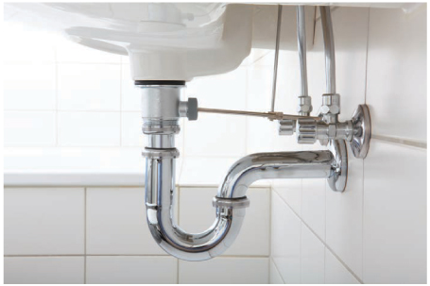
IPC 708.1.6 – Fixture traps equivalent as cleanouts
“A fixture trap or fixture with integral trap, removable without altering concealed piping, shall be acceptable as a cleanout equivalent.”
Photos courtesy of ICC, Getty Images, & MirageC/Moment

Slide 14
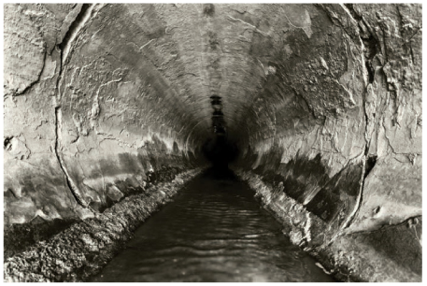
IPC 717, 718 – Drainage piping rehabilitation
Two methods introduced to rehabilitate existing building drains and building sewer piping
717 covers ‘fold and form pipe’ (FFP)
  Folded thermoplastic liner
  Expanded with air and steam
718 covers ‘cure-in-place’ (CIPP)
  Felt tube insert
  Polyester or epoxy resin
Photos courtesy of ICC, Getty Images, & MirageC/Moment

Slide 15

Thank You!
Questions?
Clayton Trevillyan, CBO
Clayton.Trevillyan@tucsonaz.gov
520-837-4913
Notes:
Thank you for your time today and we have some time for some questions?

Slide 16


Welcome

Slide 17
Dan Ice
Chief Building Official
Pima County
Contact Information
Daniel.ice@pima.gov
520-724-6493

Slide 18

Building Code Amendments
Located at: www.pima.gov/developmentservices
After the page opens, scroll halfway down the page and select “Building Resources”
After the page opens scroll to the bottom of the page to see all the building code amendments

Slide 19
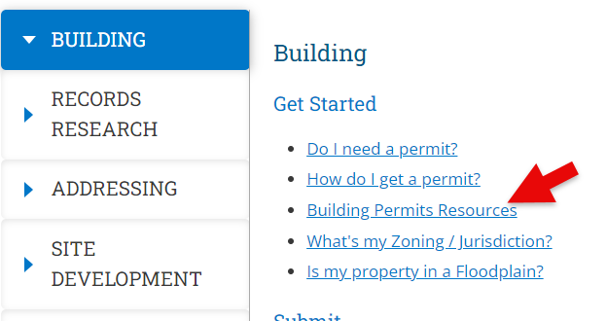
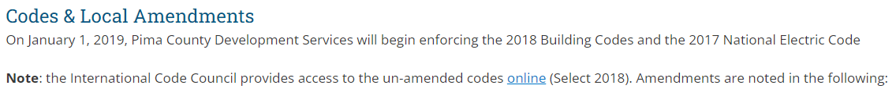
Building Code Amendments

Slide 20
Work Exempt from Permits
Residential window and door replacements in buildings legally permitted. Existing safety glazed windows shall be replaced with safety glazed windows. Existing emergency escape and rescue windows shall be same size or larger as window being replaced. Historic buildings must complete an historic review and approval prior to window installation
Repair or replacement of fixed motors and transformers of the same type and rating in the same location.
Repair or replacement of current-carrying parts of any switch, contactor, control device, or overcurrent device of the required capacity in the same location.
Electrical wiring, devices, appliances, apparatus or equipment operating at less than 25 volts and not capable of supplying more than 50 volt-amps of energy.
Replacement of evaporative coolers with like coolers
Agricultural Buildings

Slide 21
IPC Table 604.4 Maximum Flow Rates and Consumption for Plumbing Fixture Fittings
Plumbing Fixture or Fixture Fitting | Maximum Flow Rate or Quantity (b)
Lavatory, private | 1.5 gpm at 60 psi
Lavatory, public | 0.25 gallon per metering cycle
Lavatory, public (other than metering) | 0.5 gpm at 60 psi
Showerheads | 2.0 gpm at 80 psi
Sink faucet | 1.8 gpm at 80 psi
Flushing Urinals | 0.5 gallons/flush
Water Closet | 1.28 gallons/flush

Slide 22
Amendment Differences with COT’s
COT works with Tucson Fire
20+ fire districts in Unincorporated Pima County.
  Applicant’s responsibility to work directly with project locations fire district
Section 101.4.5 Fire prevention. REVISE section by DELETING the paragraph and REPLACING it with the following:
The provisions of the International Fire Code shall apply whenever referenced in this code or as deemed necessary by the Building Official. Enforcement of the Fire Code shall, however, be relegated to the fire jurisdiction having authority or to the designated responding fire department.

Slide 23
Amendment Differences with COT’s
  Pima County:
  Adopts Sections of the Property Maintenance Code
  Adopts International Wildland Urban Interface Code
  Requires Waterless Urinals in New Construction
  When Flushing Urinal is replaced, every effort shall be made to replace it with a waterless urinal.

Slide 24
A2L Refrigerants
EPA Final Rule:
Effective Date: January 13, 2025
Now provides until January 1, 2027, for the certain new variable refrigerant flow HVAC and heat pump units manufactured in the U.S. or imported to the U.S. prior to January 1, 2026.
Also provides until January 1, 2028, for the installation of certain new variable refrigerant flow air conditioning and heat pump systems if a building permit that approves the use of a hydrofluorocarbon or blend containing a hydrofluorocarbon in such a system was issued prior to October 5, 2023, provided that the system uses components manufactured in the United States or imported into the United States prior to January 1, 2026.
This is to mitigate the potential for stranded inventory.

Slide 25
A2L Refrigerants
A Rule by the Environmental Protection Agency on 12/26/2023
The U.S. Environmental Protection Agency is amending a provision of the recently finalized Technology Transitions Program under the American Innovation and Manufacturing Act (AIM Act). This action allows one additional year, until January 1, 2026, solely for the installation of new residential and light commercial air conditioning and heat pump systems using components manufactured or imported prior to January 1, 2025.
EPA is promulgating this action to mitigate the potential for significant stranded inventory in this subsector.
The existing January 1, 2025, compliance date for the installation of certain residential and light commercial air conditioning and heat pump systems may result in significant stranded inventory that was intended for new residential construction.

Slide 26
Jurisdictional A2L Policy
Alternative Refrigerants
Applicable Code Sections:
  International Mechanical Code Chapter 11
  International Residential Code Chapter 14
Policy:
  Refrigeration systems may be designed and installed in accordance with the currently adopted International Mechanical Code (or International Residential Code as applicable) or the most current edition of ANSI/ASHRAE 15 with the companion standard ANSI/ASHRAE 34.
Process:
  Permit applicants seeking to use alternative refrigerants that are not identified in the adopted building safety codes shall declare the use of ANSI/ASHRAE 15 with the companion standard ANSI/ASHRAE 34 for system designs on permit application and/or the construction documents prior to submitting a permit application.

Slide 27
Electrical Changes of Interest
Islands or Peninsular Countertops
If a receptacle outlet is not provided to serve an island or peninsular countertop or work surface, provisions shall be provided at the island or peninsula for future addition of a receptacle outlet to serve the island or peninsular countertop or work surface.
Required receptacle outlets shall be located in one or more of the following:
1.On or above, but not more than 20 inches (508 mm) above, the countertop or work surface.
2.In a countertop using receptacle outlet assemblies listed for the use in countertops.
3.In a work surface using receptacle outlet assemblies listed for use in work surfaces or listed for use in countertops. [210.52(C)(3)]

Slide 28
Electrical Changes of Interest

Slide 29
Electrical Changes of Interest

Slide 30
Electrical Changes of Interest

Slide 31
Electrical Changes of Interest

Slide 32
Electrical Changes of Interest

Slide 33
Electrical Changes of Interest

Slide 34
Electrical Changes of Interest

Slide 35
Electrical Changes of Interest

Slide 36
Thank you!
Questions?

Slide 37
The Town of Oro Valley
Building Code Amendments
Jan 15th ACT Dinner – 5:00 – 7:30pm (Wed)
Code updates from Chief Building Officials

Slide 38
Agenda
Regional adoption helps create regional consistency among local jurisdictions with code standards and amendments to prevent inequitable development conditions.
Amendments found on the TOV website. https://www.orovalleyaz.gov/Government/Departments/Community-and-Economic-Development/Building-Codes-and-Amendments
The Town of Oro Valley’s tentative schedule is like The City of Tucson and Pima County including adoption in early (March/April 2025) with purposed implementation effective July 1, 2025.
Key takeaways:
Majority of TOV amendments are consistent with local COT and Pima Co. Jurisdictions amendments.
Proposal to OV Town Council to adopt amendments for the 2024 IFC and local amendments from Golder Ranch Fire District and Northwest Fire District in their entirety. (PDF available)
First time adoption of the 2024 International Existing Building Code (IEBC). Creating regional consistency and additional options for builders to meet minimum code.

Slide 39
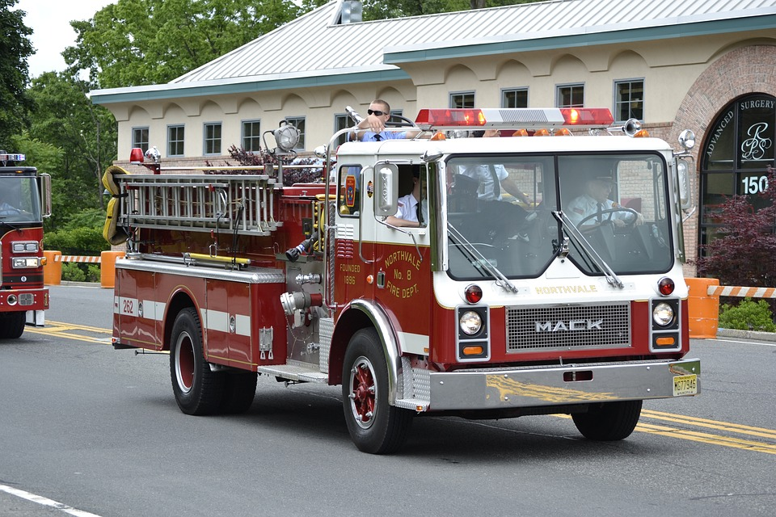
INTERNATIONAL FIRE CODE, 2024 EDITION
Town of Oro Valley is adopting 2024 IFC with GRFD/NWFD Amendments of the 2024 IFC, pending TOV Council approval

Slide 40


Town of Oro Valley adopted International Codes
INTERNATIONAL RESIDENTIAL CODE, 2024 EDITION
INTERNATIONAL SWIMMING POOL AND SPA CODE, 2024 EDITION
INTERNATIONAL EXISTING BUILDING CODE, 2024 EDITION (New to TOV)
INTERNATIONAL FIRE CODE, 2024 EDITION (Adopting (GRFD) amendments)
INTERNATIONAL PROPERTY MAINTENANCE CODE, 2024 EDITION
INTERNATIONAL PLUMBING, 2024 EDITION
INTERNATIONAL MECHANICAL CODE, 2024 EDITION
INTERNATIONAL FUEL GAS CODE, 2024 EDITION
INTERNATIONAL ENERGY CONSERVATION CODE, 2024 EDITION
INTERNATIONAL BUILDING CODE, 2024 EDITION
NATIONAL ELECTRICAL CODE, 2023 EDITION

Slide 41
INTERNATIONAL RESIDENTIAL CODE, 2024 EDITION
Add new section R325.9 as follows:
SECTION R325.9 REQUIRED COOLING. DWELLING UNITS AND SLEEPING UNITS LOCATED IN CLIMATE ZONES 0, 1, 2, 3, 4, 5A, AND 5B, WHERE THE SUMMER DRY-BULB TEMPERATURE IS GREATER THAN 85º F (29.4º C), SHALL BE PROVIDED WITH COOLING SYSTEMS CAPABLE OF MAINTAINING AN INDOOR TEMPERATURE AT OR BELOW 80ºF (26.7º C) IN THE OCCUPIED SPACE. WHERE PERMANENTLY INSTALLED FANS ARE CAPABLE OF GENERATING 120 FPM (0.6 M/S) AIR SPEED INSIDE THE OCCUPIED SPACE, THE REQUIRED COOLING SYSTEM SHALL BE CAPABLE OF MAINTAINING INDOOR TEMPERATURE AT OR BELOW 85º F (29.4º C). THE INSTALLATION OF ONE OR MORE PORTABLE SYSTEMS SHALL NOT BE USED TO ACHIEVE COMPLIANCE WITH THIS SECTION.
EXCEPTION: INTERIOR SPACES WHERE THE PRIMARY PURPOSE IS NOT ASSOCIATED WITH HUMAN COMFORT.
Subject to TOV Council approval

Slide 42
INTERNATIONAL RESIDENTIAL CODE, 2024 EDITION CONTINUED
Revise section E3901.4.2 as the following: E3901.4.2 Island and Peninsular countertops and work surfaces.
RECEPTACLE OUTLETS, IF INSTALLED TO SERVE AN ISLAND OR PENINSULAR COUNTERTOP OR WORK SURFACE, SHALL BE INSTALLED IN ACCORDANCE WITH SECTION E3901.4.3 IF A RECEPTACLE OUTLET IS NOT PROVIDED TO SERVE AN ISLAND OR PENINSULAR COUNTERTOP OR WORK SURFACE, PROVISIONS SHALL BE PROVIDED AT THE ISLAND OR PENINSULAR FOR FUTURE ADDITION OF A RECEPTACLE OUTLET TO SERVE THE ISLAND OR PENINSULAR COUNTERTOP OR WORK SURFACE BY ADDING A CONDUIT AND JUNCTION BOX LABELED, “FUTURE RECEPTACLE(S) MUST OBTAIN ELECTRICAL PERMIT”

Slide 43
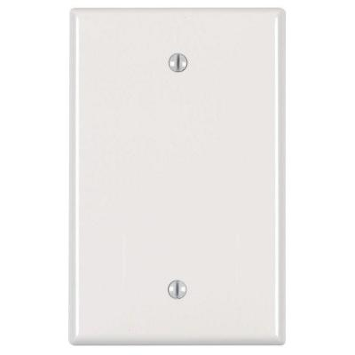
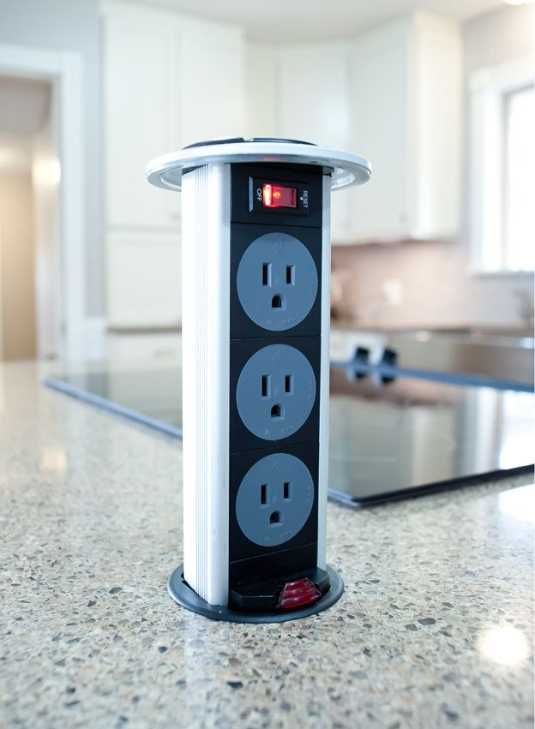
Options to comply to E3901.4.2 Island and Peninsular countertops and work surfaces.
FUTURE RECEPTACLE MUST OBTAIN ELECTRICAL PERMIT
This Photo by Unknown Author is licensed under CC BY-SA
This Photo by Unknown Author is licensed under CC BY-SA

Slide 44
INTERNATIONAL RESIDENTIAL CODE, 2024 EDITION CONTINUED
Section NE101.2 Electric vehicle power transfer infrastructure. REVISE Section by DELETING the Section in its entirety and REPLACE with the following:
NEW CONSTRUCTION SHALL FACILITATE FUTURE INSTALLATION AND USE OF ELECTRIC VEHICLE SUPPLY EQUIPMENT (EVSE) IN ACCORDANCE WITH SECTIONS NE101.2.1 THROUGH NE101.3 AND NFPA-70, NATIONAL ELECTRICAL CODE AS ADOPTED.
Section NE101.2.1 Quantity. DELETE Section in its entirety and REPLACE with the following:
FOR EACH NEW ONE- AND TWO-FAMILY DWELLING AND TOWNHOUSE UNIT, PROVIDE AT LEAST ONE EV READY SPACE. THE BRANCH CIRCUIT SHALL BE IDENTIFIED AS “EV READY” IN THE SERVICE PANEL OR SUBPANEL DIRECTORY, AND THE TERMINATION LOCATION SHALL BE MARKED AS “EV READY.”
EXCEPTION: EV READY SPACES ARE NOT REQUIRED WHERE NO ON-SITE PARKING SPACES ARE PROVIDED.

Slide 45
INTERNATIONAL SWIMMING POOL AND SPA CODE, 2024 EDITION
SECTION 809.9 Maximum depth.
REVISE Section by ADDING a new subsection to read:
SECTION 809.9.1 UNDERWATER SEATS AND BENCHES:
UNDERWATER SEATS AND BENCHES, WHETHER USED ALONE OR IN CONJUNCTION WITH POOL STAIRS, SHALL COMPLY WITH ALL OF THE FOLLOWING:
  THE HORIZONTAL SURFACE SHALL BE AT OR BELOW THE WATERLINE
  THE HORIZONTAL SURFACE SHALL BE NOT GREATER THAN 20 INCHES (508 MM) BELOW THE WATERLINE.
  AN UNOBSTRUCTED SURFACE SHALL BE PROVIDED THAT IS NOT LESS THAN 10 INCHES (254 MM) IN DEPTH AND NOT LESS THAN 24 INCHES (607 MM) IN WIDTH.
  UNDERWATER SEATS AND BENCHES SHALL NOT BE USED AS THE REQUIRED ENTRY AND EXIT ACCESS.
  WHERE UNDERWATER SEATS ARE LOCATED IN THE DEEP AREA OF THE POOL WHERE MANUFACTURED OR CONSTRUCTED DIVING EQUIPMENT IS INSTALLED, SUCH SEATS SHALL BE LOCATED OUTSIDE OF THE MINIMUM DIVING WATER ENVELOPE FOR DIVING EQUIPMENT.
  THE TOP LEADING EDGE OF THE UNDERWATER SEAT OR BENCH SHALL BE CONTRASTING AND VISUALLY SET APART BY USING AN UNDERWATER ACCENT TILE OR MARKER SOLID OR SPACED A MAXIMUM OF 10” INCHES (254 MM) APART WITH A MINIMUM OF AT LEAST THREE MARKERS.
  A TANNING LEDGE OR SUN SHELF USED AS THE REQUIRED ENTRY AND EXIT ACCESS SHALL BE LOCATED NOT GREATER THAN 12 INCHES (305 MM) BELOW THE WATERLINE.

Slide 46



Slide 47
Thank you!
Larry Merrell
Building Official
Lmerrell@orovalleyaz.gov

Slide 48


TOWN OF SAHUARITA
SIGNIFICANT CHANGES TO THE 2024 ICC

Slide 49
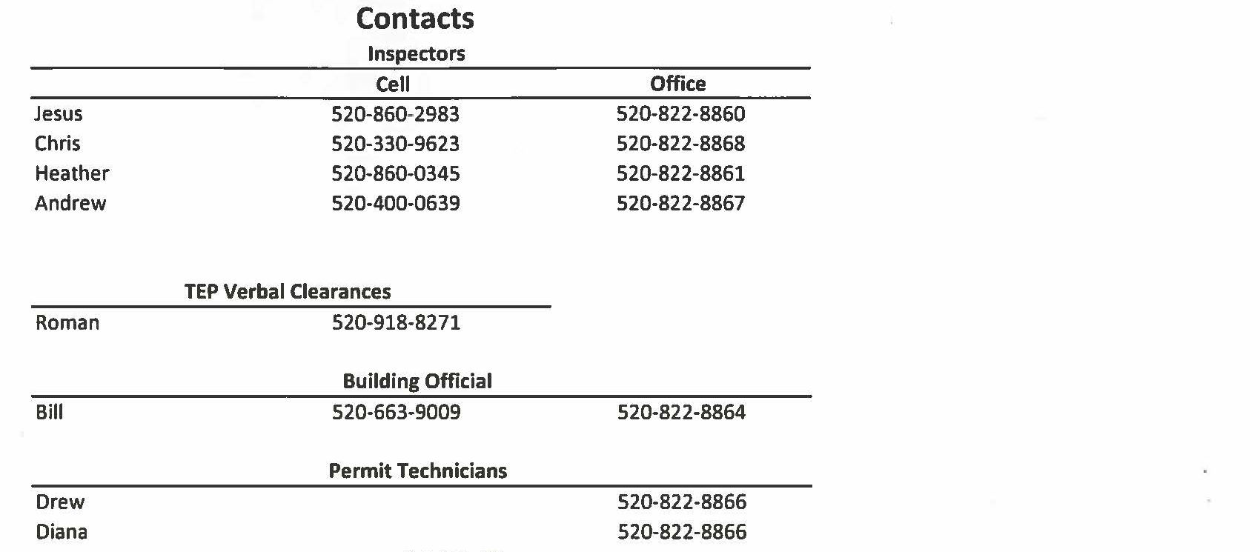

Slide 50
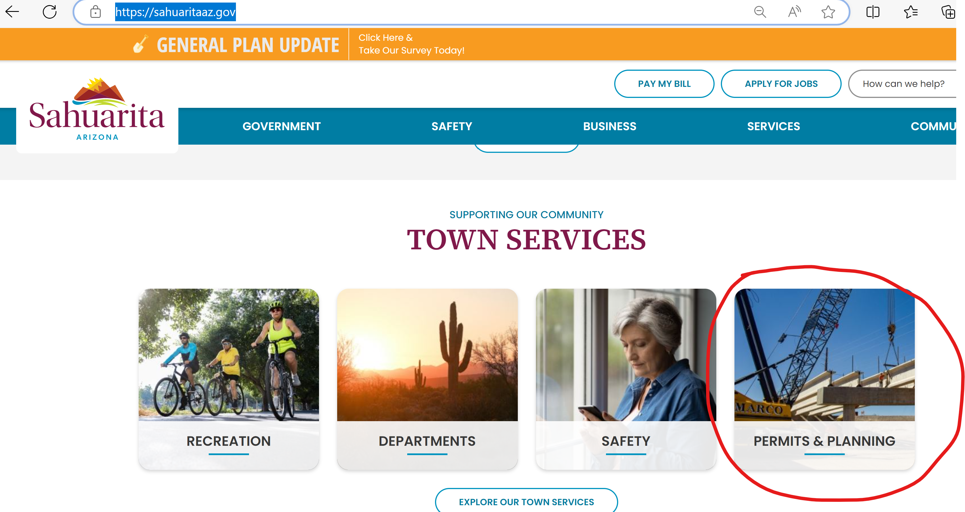
  Log in to : WWW.SAHUARITAAZ.GOV
  Search for the PERMITS & PLANNING IMAGE
TOWN OF SAHUARITA
How to access the Town’s Amendments to the Building Codes in the Town of Sahuarita website

Slide 51
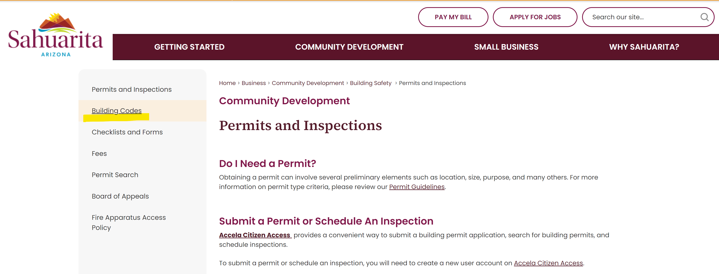
  Click on the Building Codes (Side Menu)

Slide 52
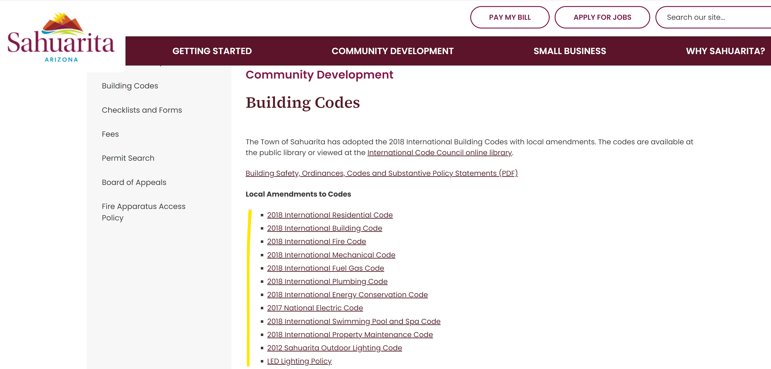
  The Amendments to the IBC Codes are listed.
  Each link will open a PDF file that can be downloaded

Slide 53
PERMITS
All the model home permits will be good up to a year of previous submittal.
Any permit applied for after the adoption of the 2024 Building Codes by Town Council will have to be designed to meet the criteria of the 2024 Building Codes and amendments.
Permits applied for prior to the adoption of the 2024 Building Codes by the Town Council will be reviewed, permitted and inspected under the current 2018 Building Codes and amendments.

Slide 54
IMC 306.5- Equipment and Appliances on Roofs and Elevated Structures
The side railing shall extend above the parapet or roof edge or landing platform not < 30 inches <42 inches
Ladders shall have rung spacing not <10 inches
Ladders shall have toe spacing not < 6 inches <7 inches
There shall be not < 18 inches < 16 inches between rails
Top landing required. The ladder shall be provided with a clear and unobstructed landing on the exit side of the roof hatch, having a minimum space of 30 inches deep and being the same with as the hatch.

Slide 55
IMC 506.3.2.5- Grease Duct Test
A field test should be performed prior of use of a grease duct system.
506.3.2.5.1 - Light Test
  A duct test shall be performed by passing a lamp not < 1600 lumens
506.3.2.5.2 – Water Spray Test
  Water pump with outlet pressure not < than 1200 psi shall be used to apply high pressure water to the inside surfaces of the duct

Slide 56
IBC 718.2.1 – Fire Blocking Materials
One thickness of 19/32 inch fire-retardant-treated wood structural panel has been added to the listing of materials permitted to be used as fireblocking.

Slide 57
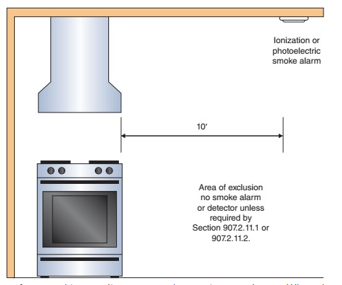
IFC 907.2.11.3 – Installation of Cooking Appliance
Smoke alarms shall be installed not less than 10 feet horizontally from a permanently installed cooking appliance.
Exception: Smoke alarms shall be permitted to be installed not less than 6 feet horizontally from a permanently installed cooking applicance where necessary to comply with section 907.2.11.1 or 907.2.11.2

Slide 58
Thank you!
Questions?

